Slide 1
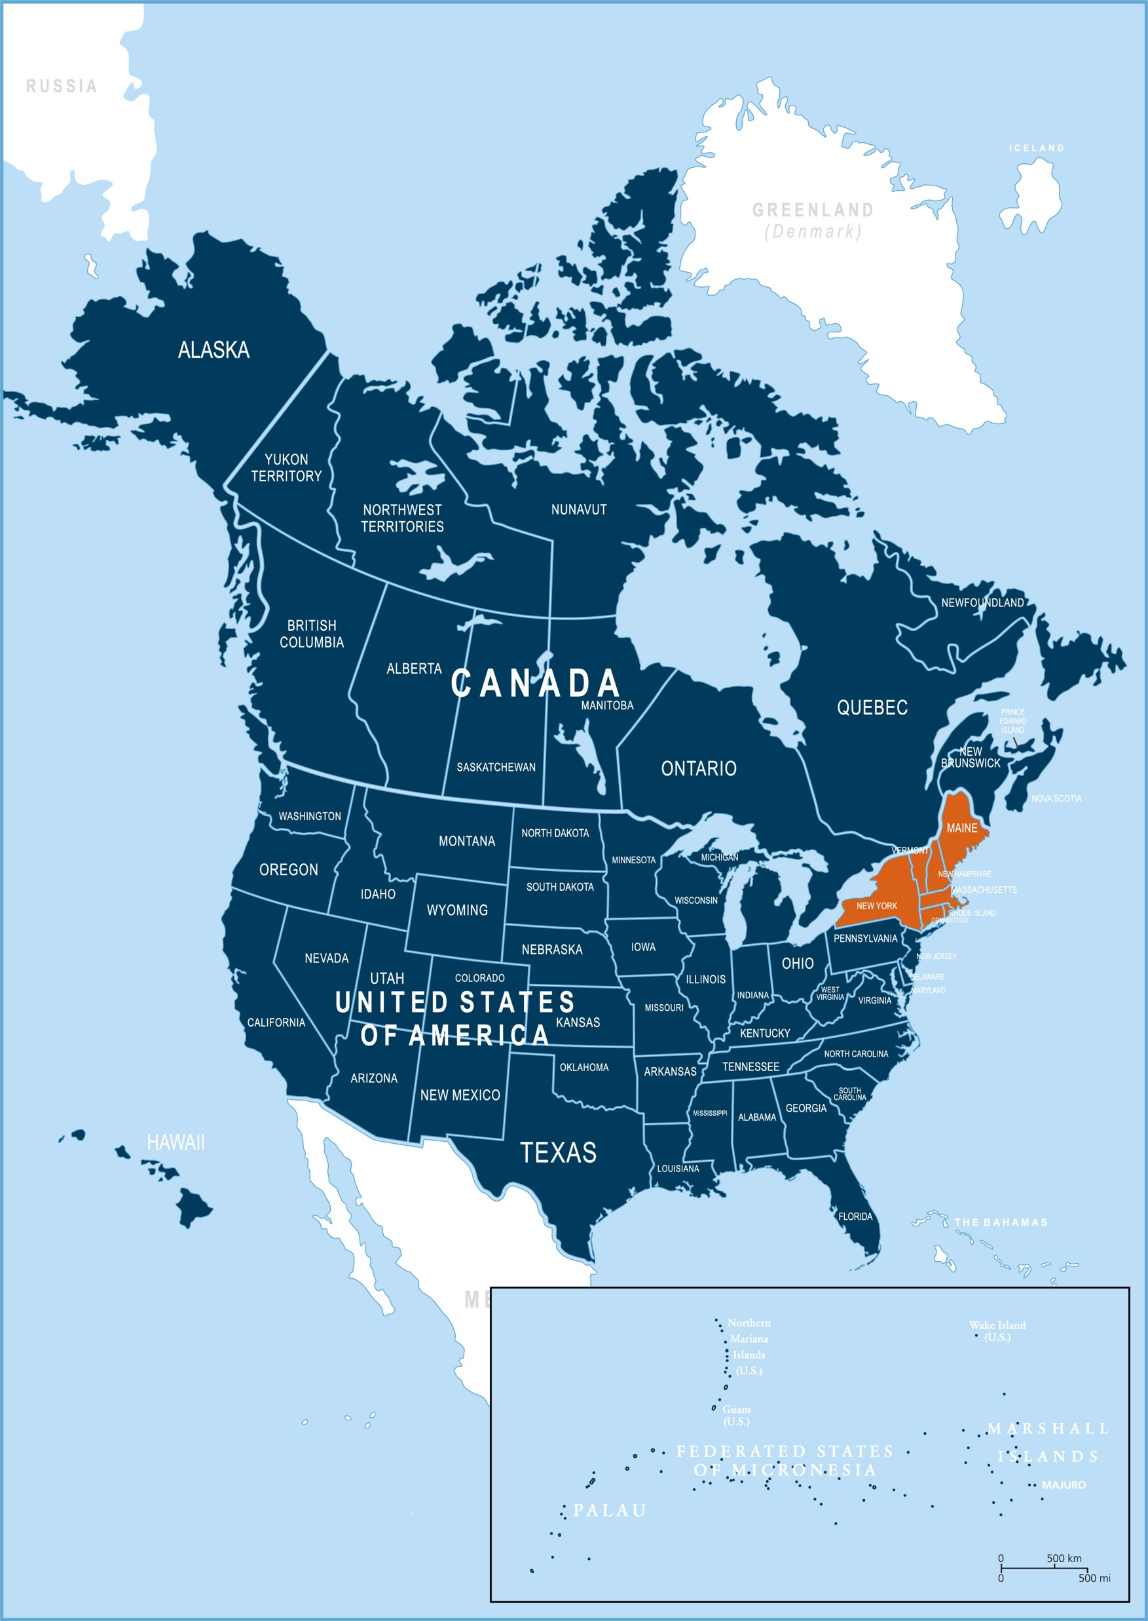
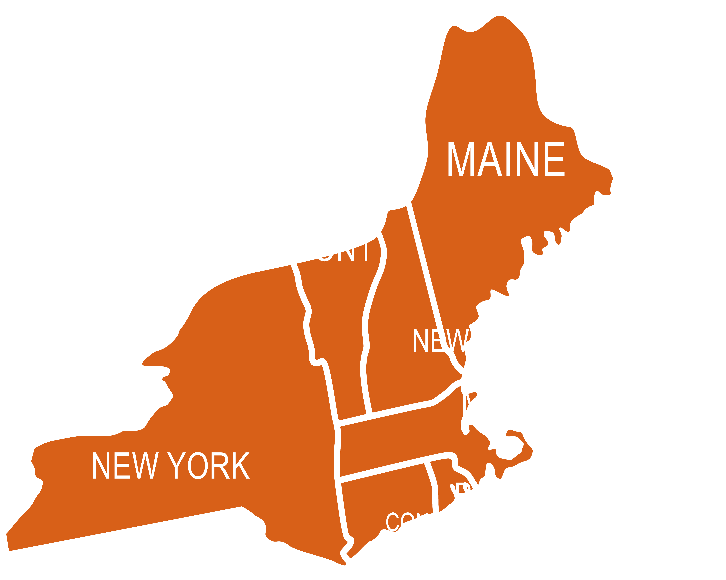
Subtitle
Atlantic Union Conference
Title
Bullet 1
Bullet 2
Bullet 3
Sub-bullet 1
Sub-bullet 2
Sub-bullet 3
Bullet 4
Bullet 5

Slide 2
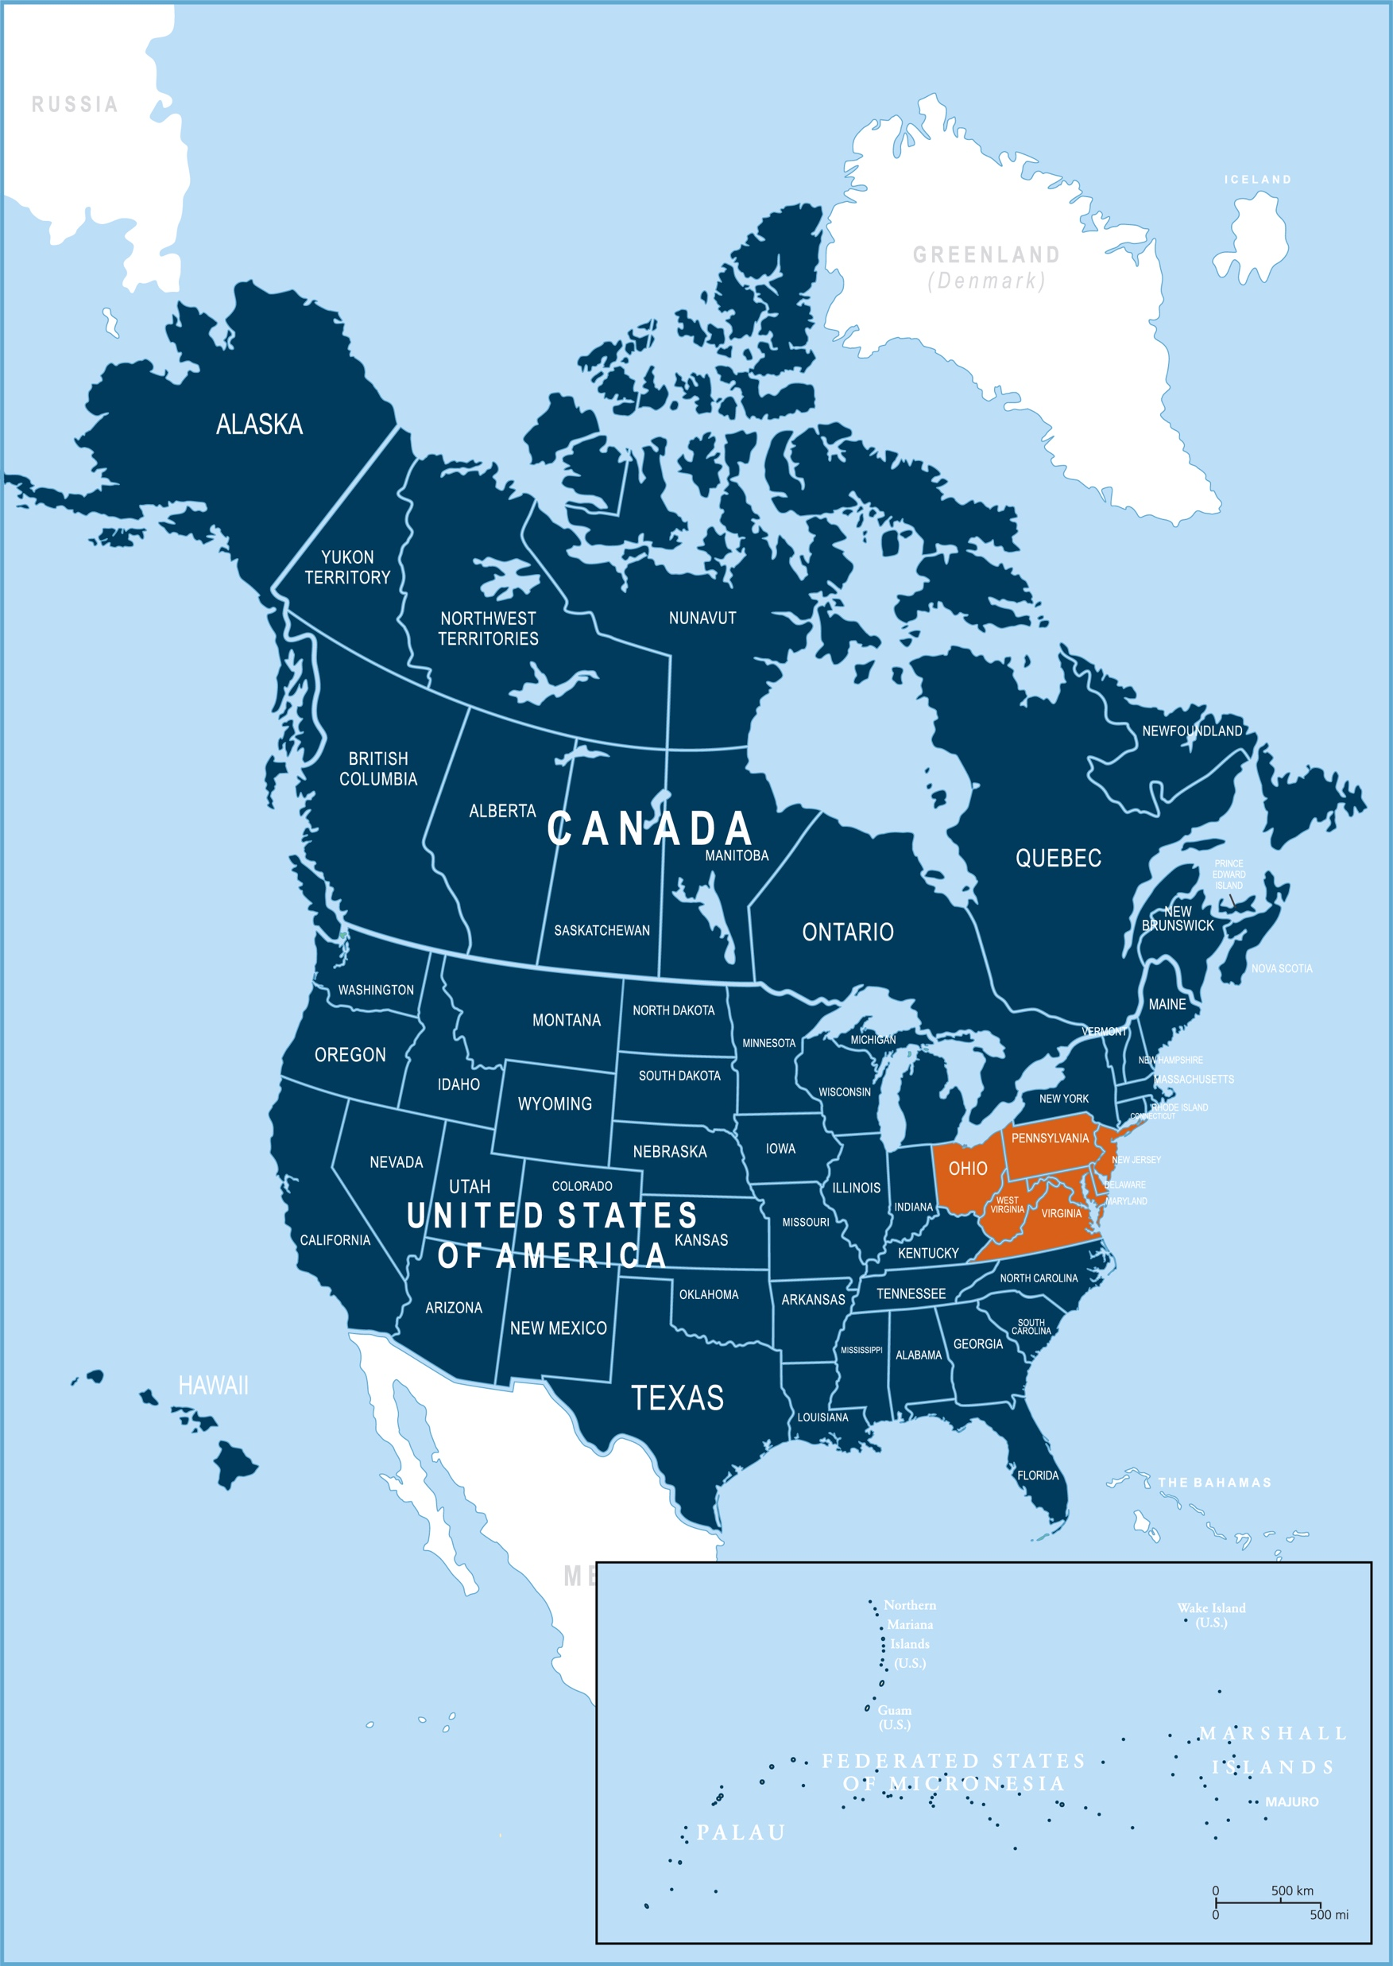
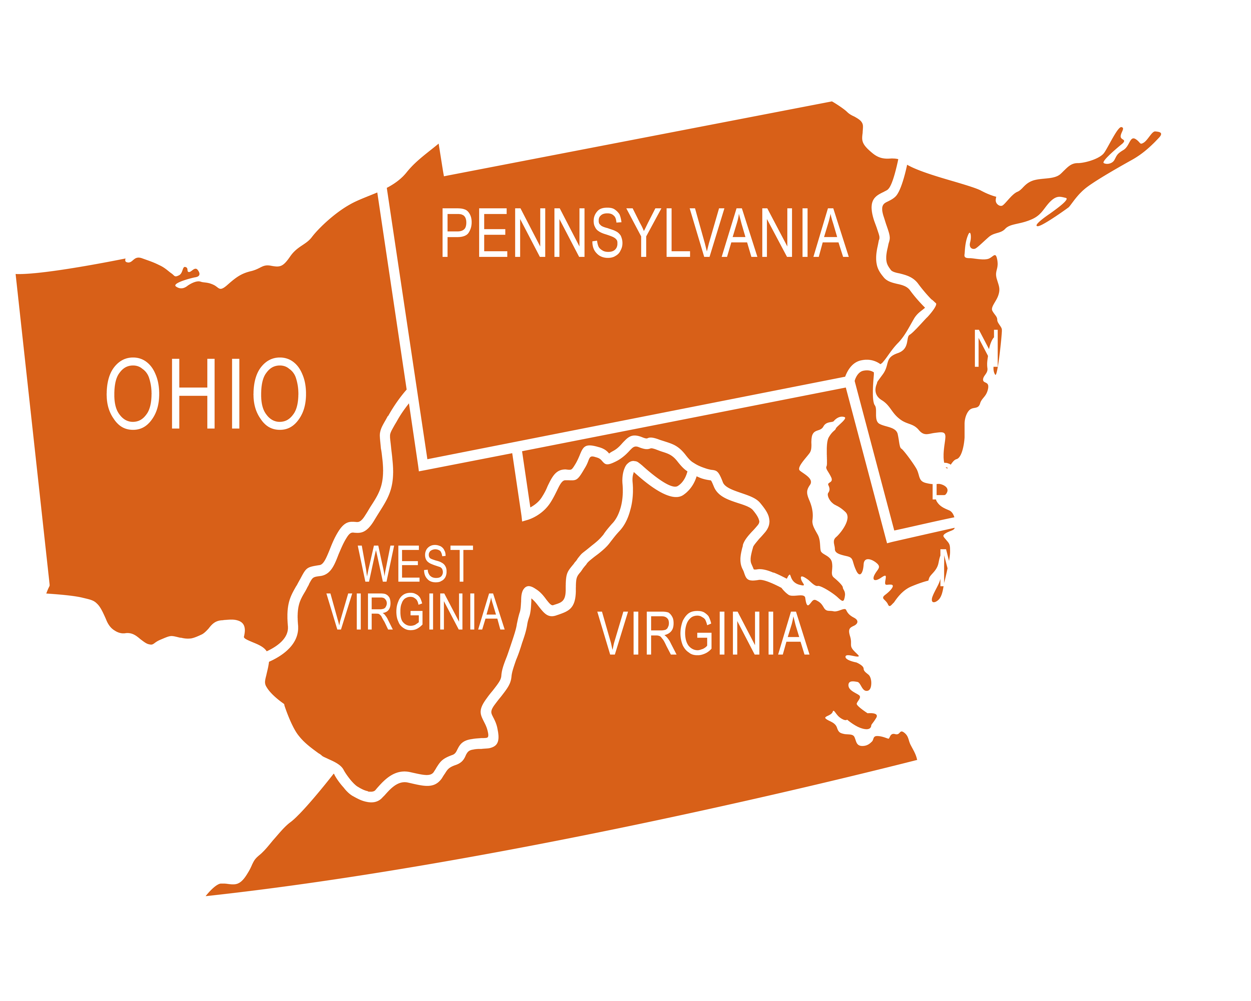
Subtitle
Columbia Union Conference
Title
Bullet 1
Bullet 2
Bullet 3
Sub-bullet 1
Sub-bullet 2
Sub-bullet 3
Bullet 4
Bullet 5

Slide 3
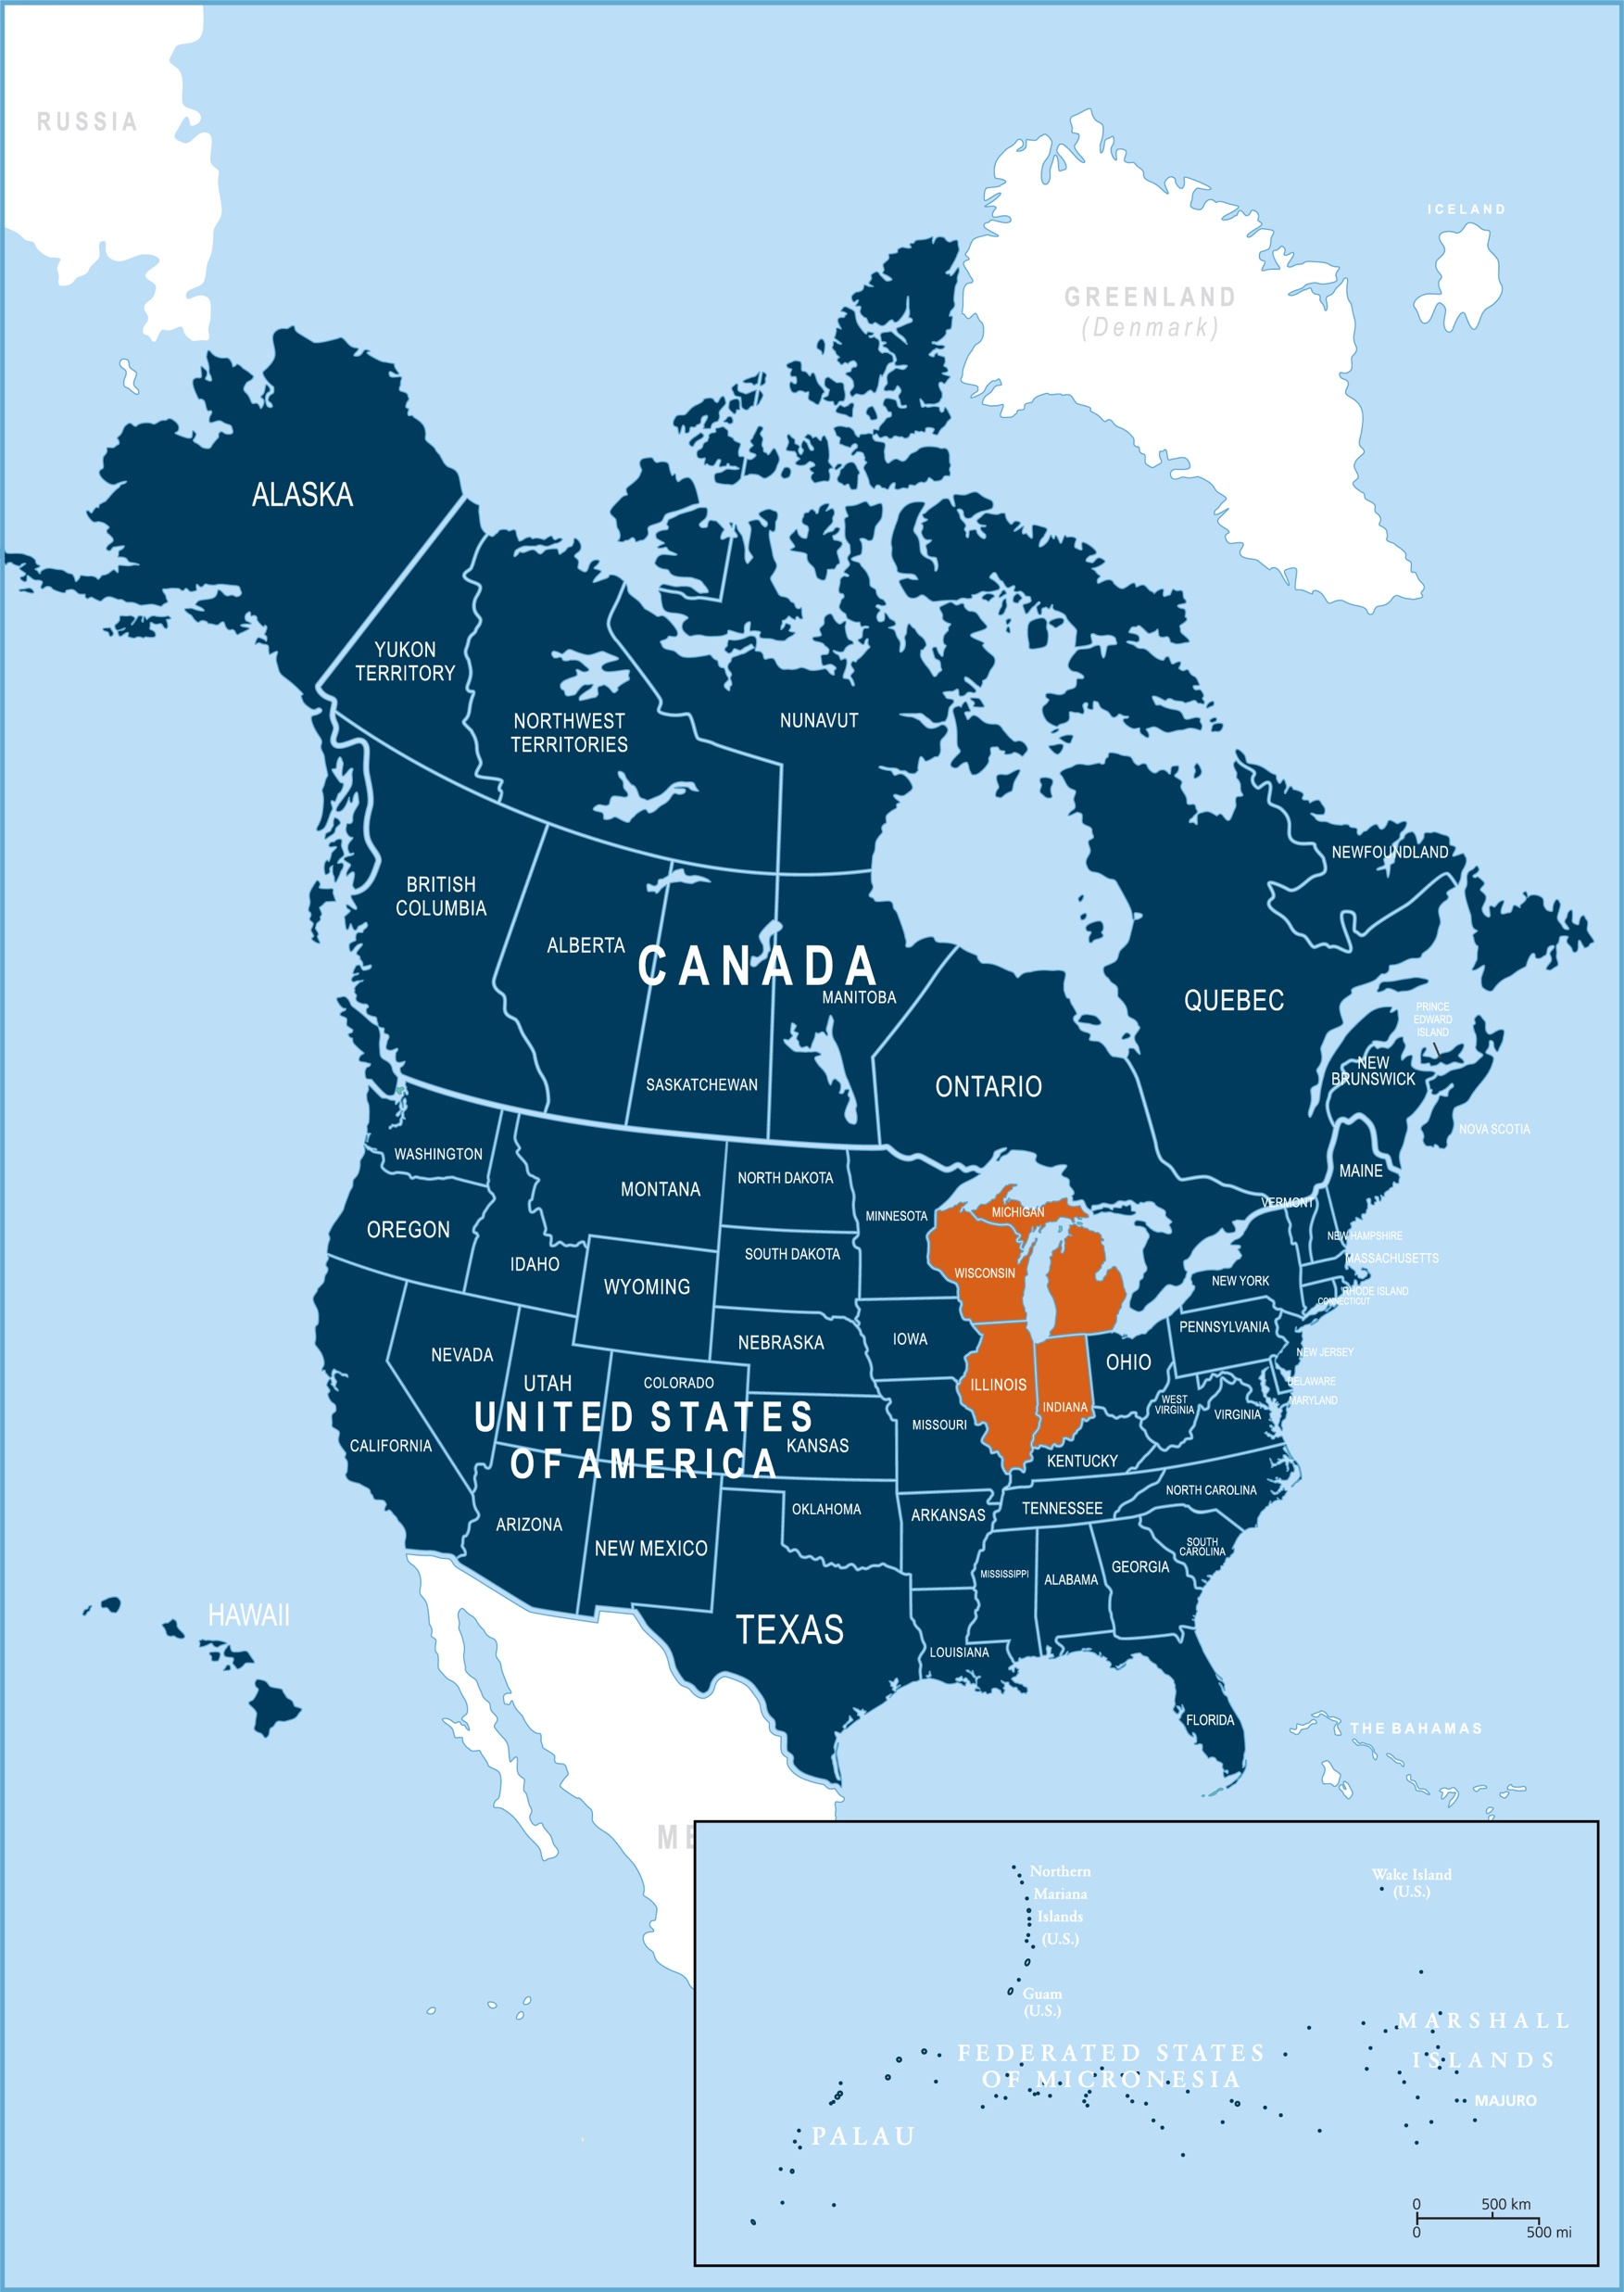
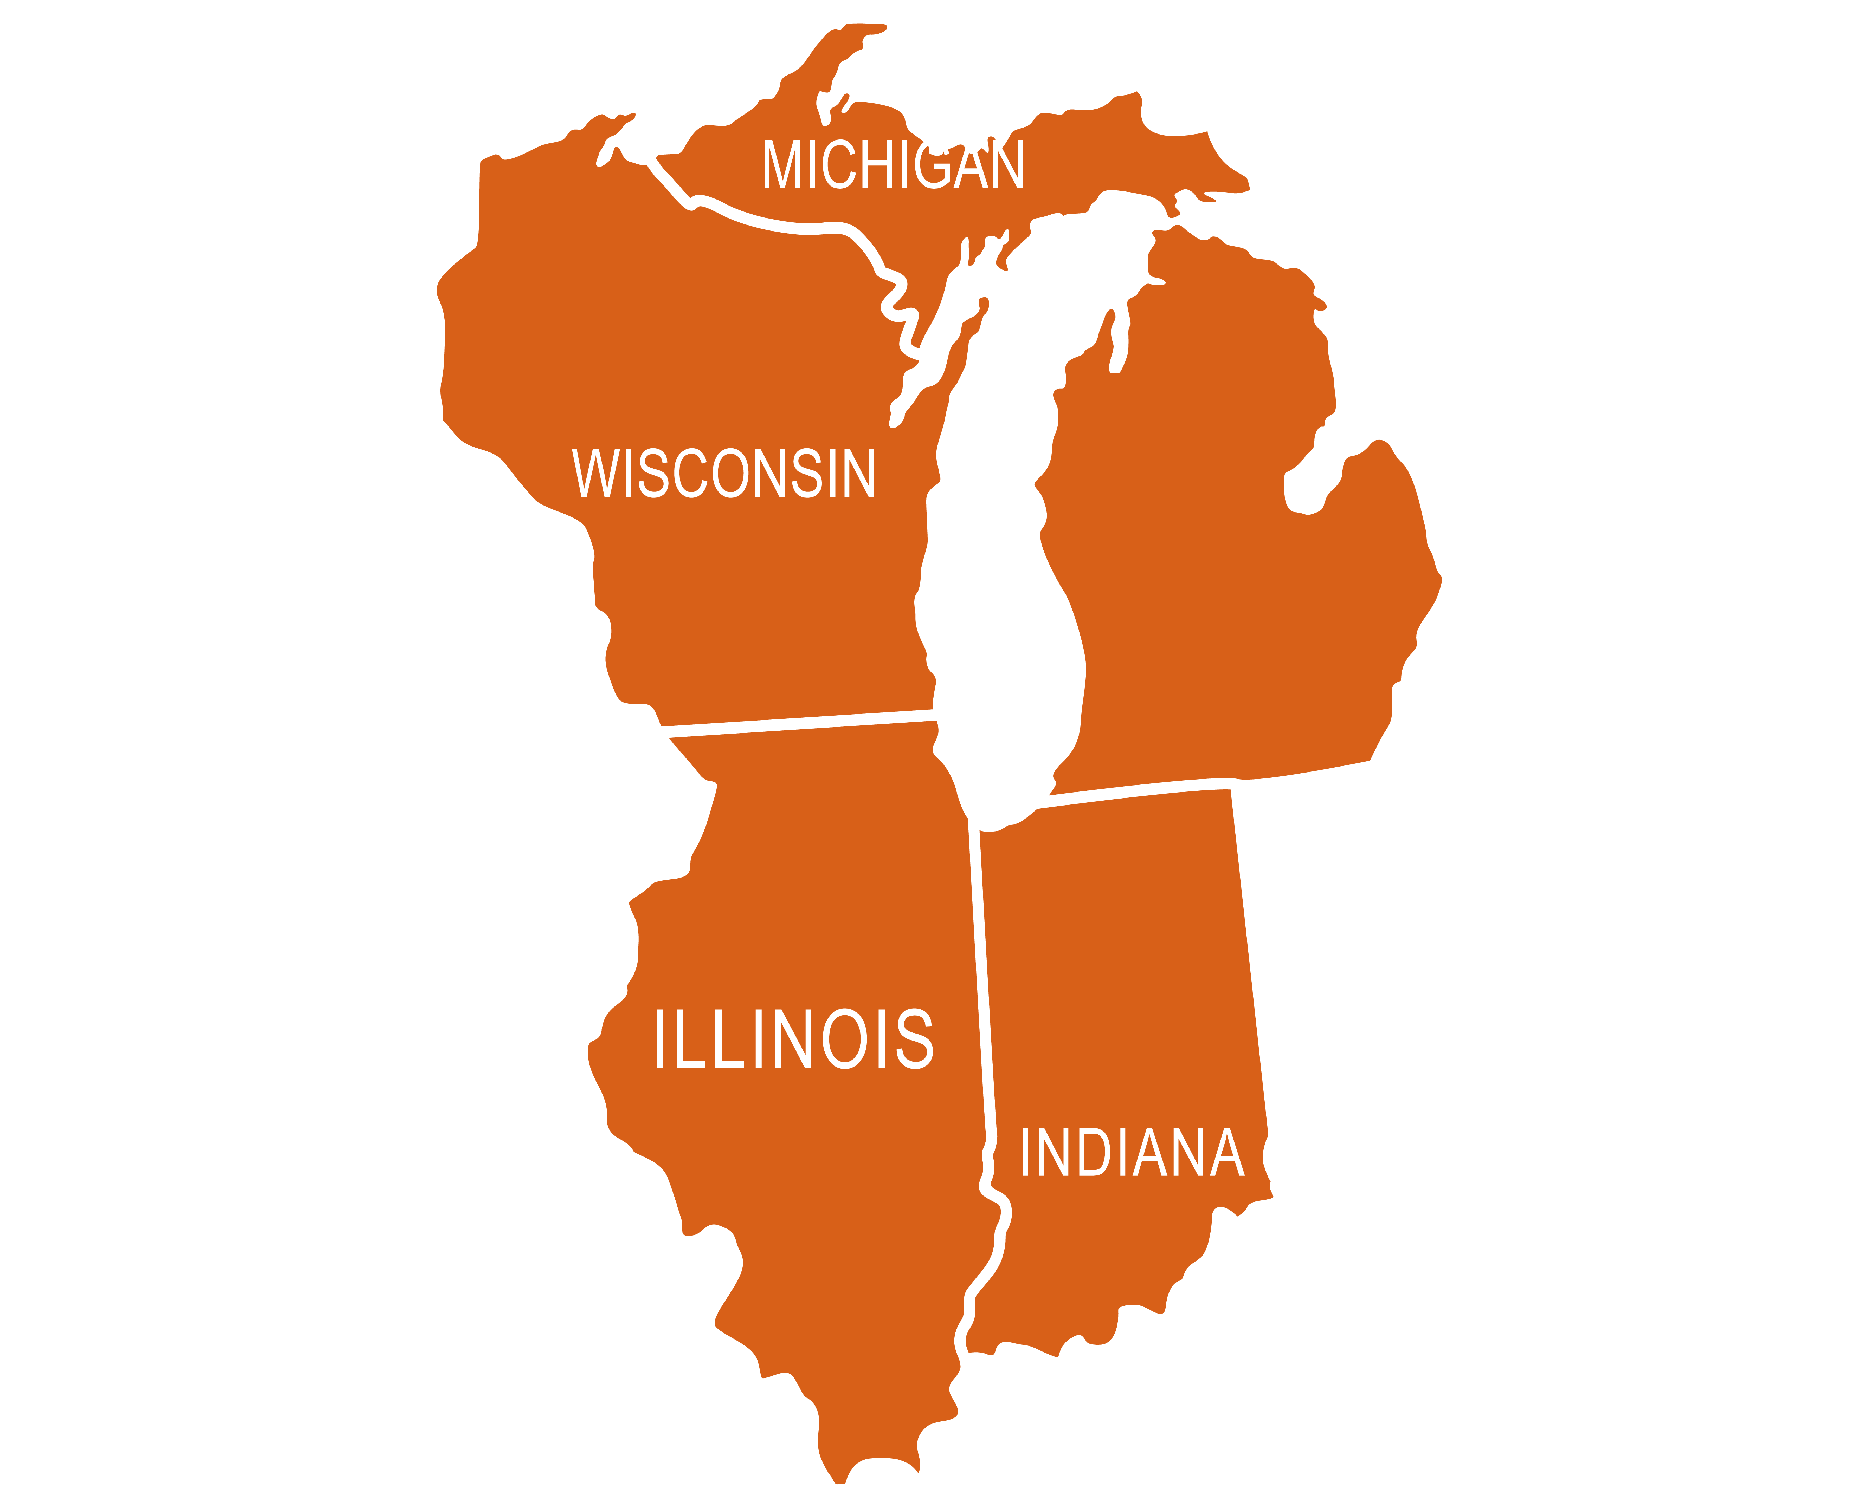
Subtitle
Lake Union Conference
Title
Bullet 1
Bullet 2
Bullet 3
Sub-bullet 1
Sub-bullet 2
Sub-bullet 3
Bullet 4
Bullet 5

Slide 4
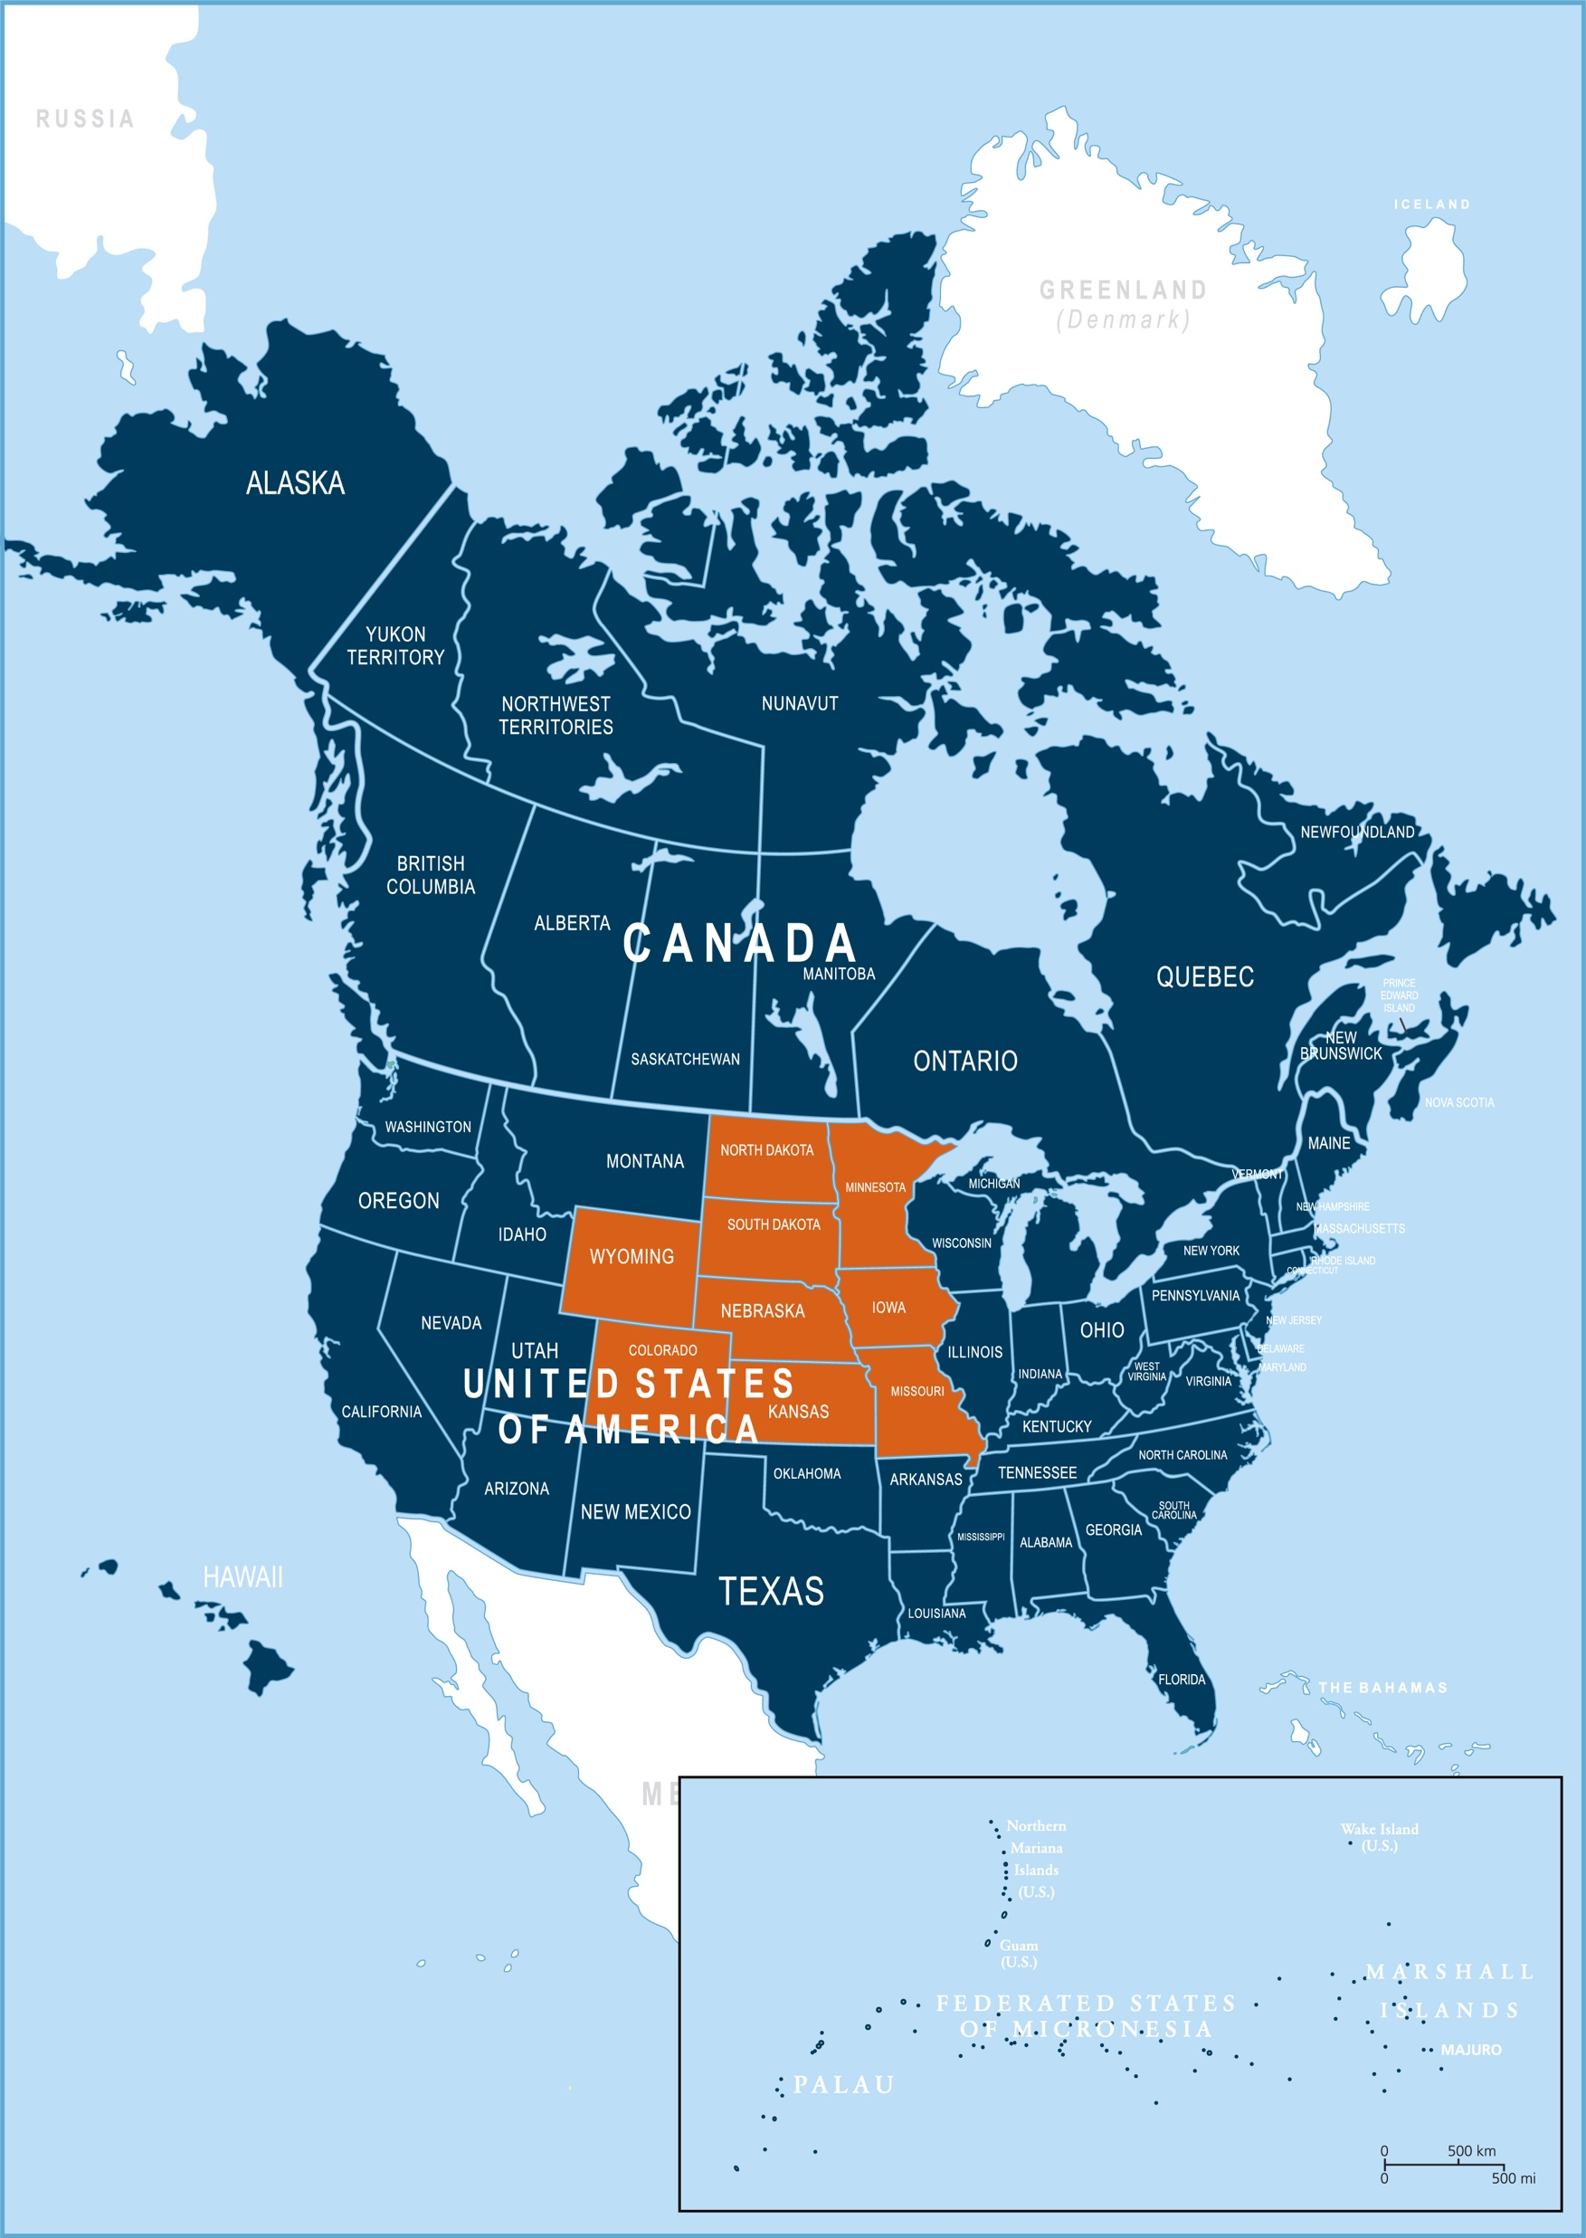
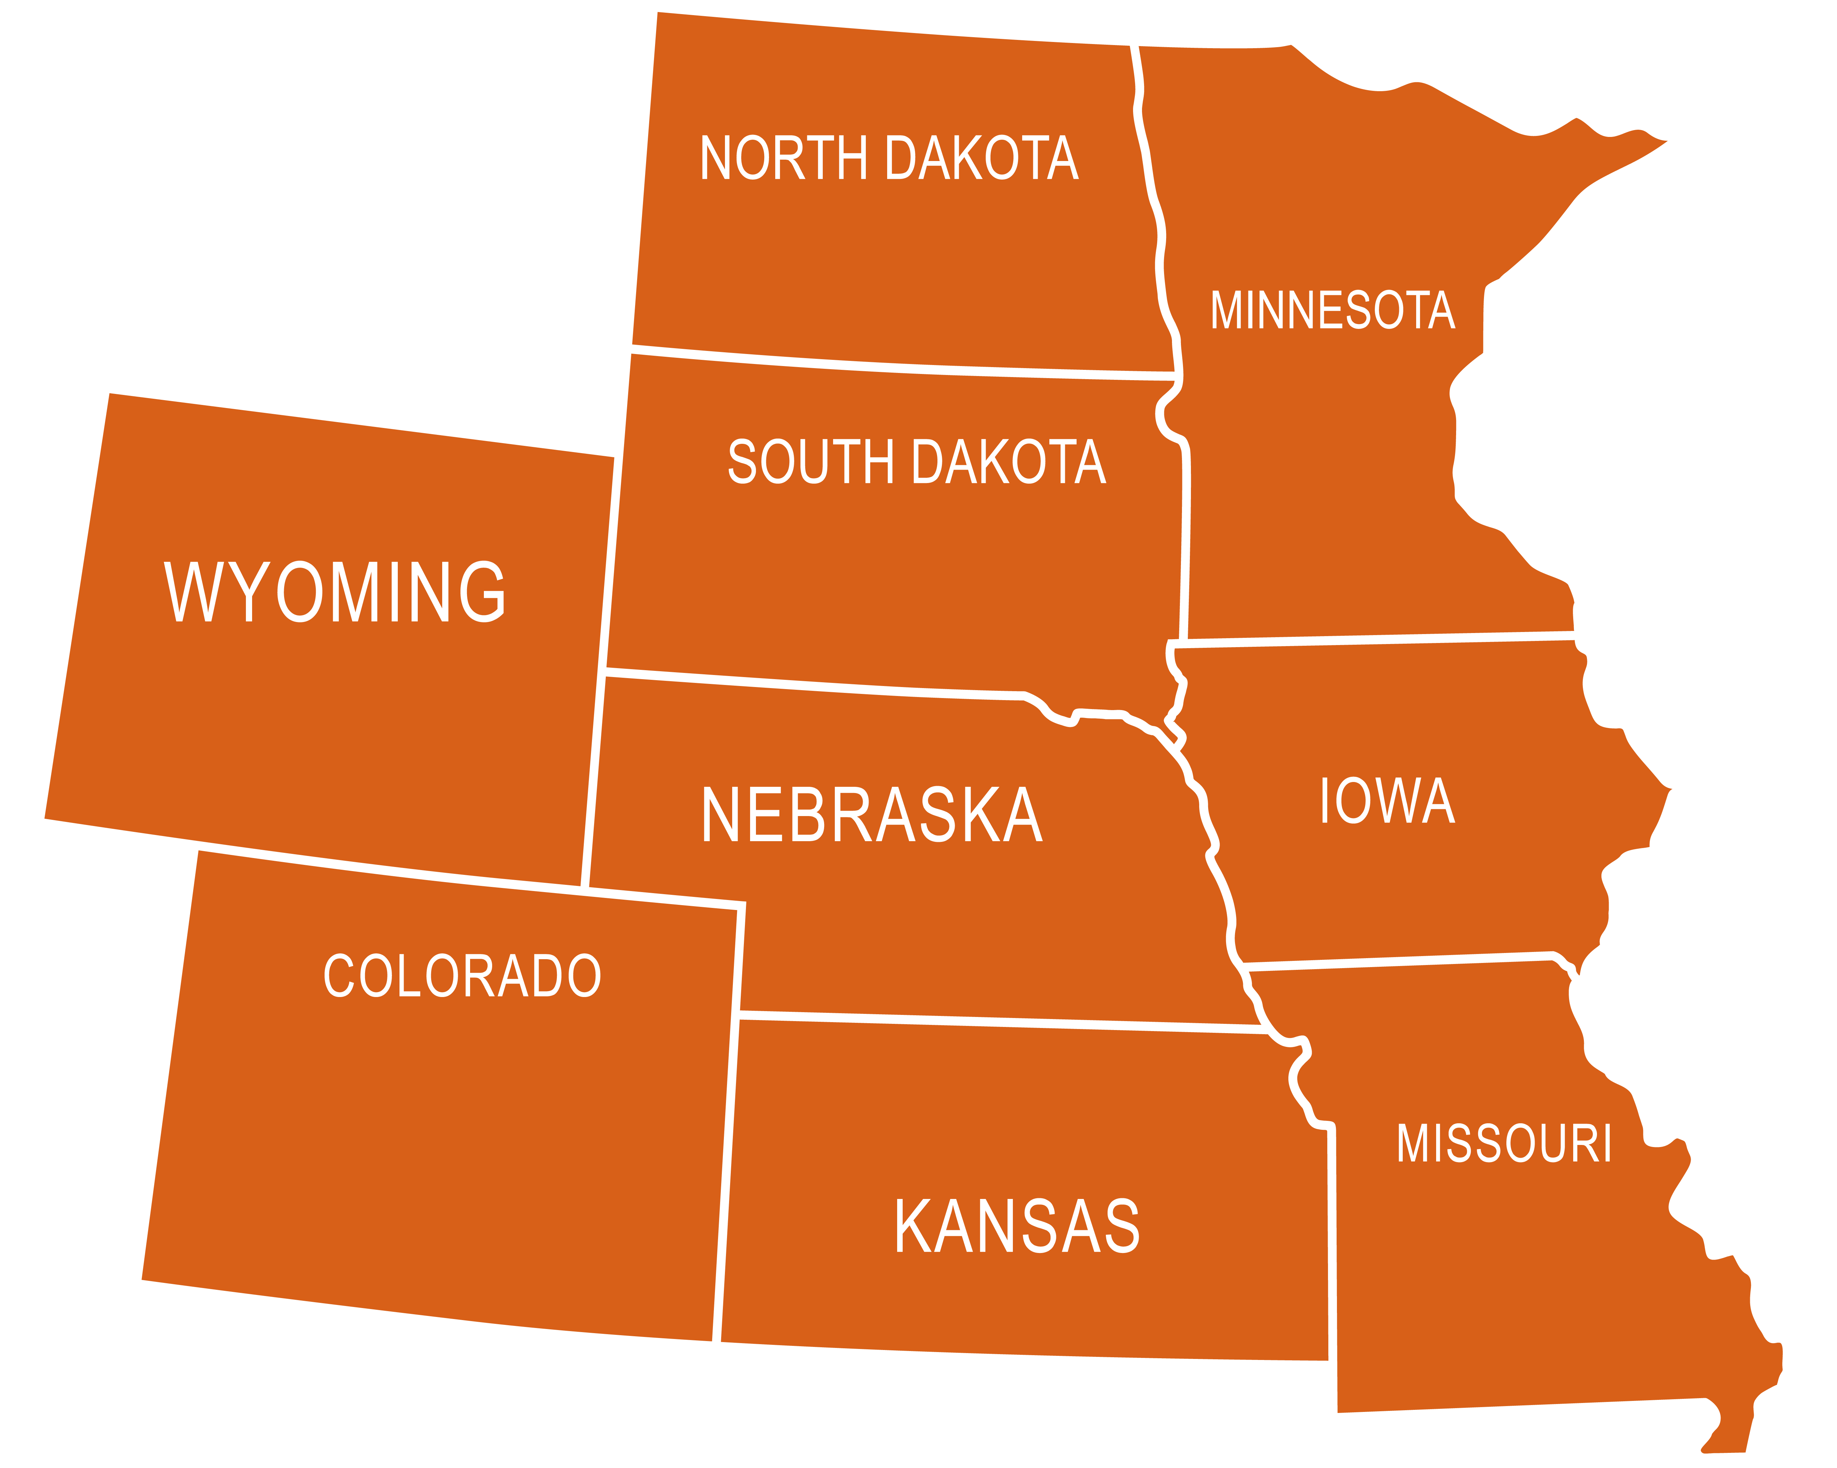
Subtitle
Mid-America Union Conference
Title
Bullet 1
Bullet 2
Bullet 3
Sub-bullet 1
Sub-bullet 2
Sub-bullet 3
Bullet 4
Bullet 5

Slide 5
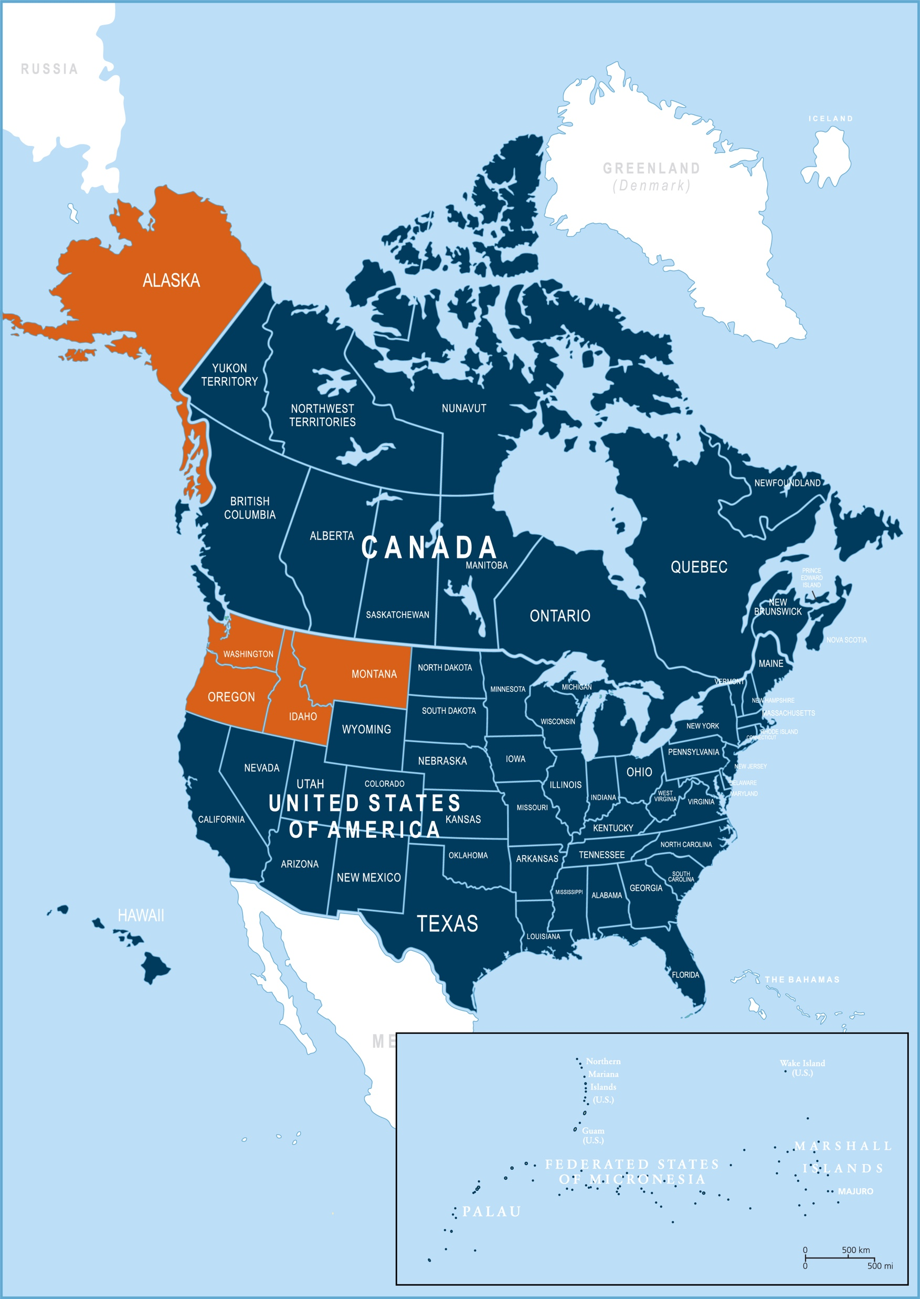
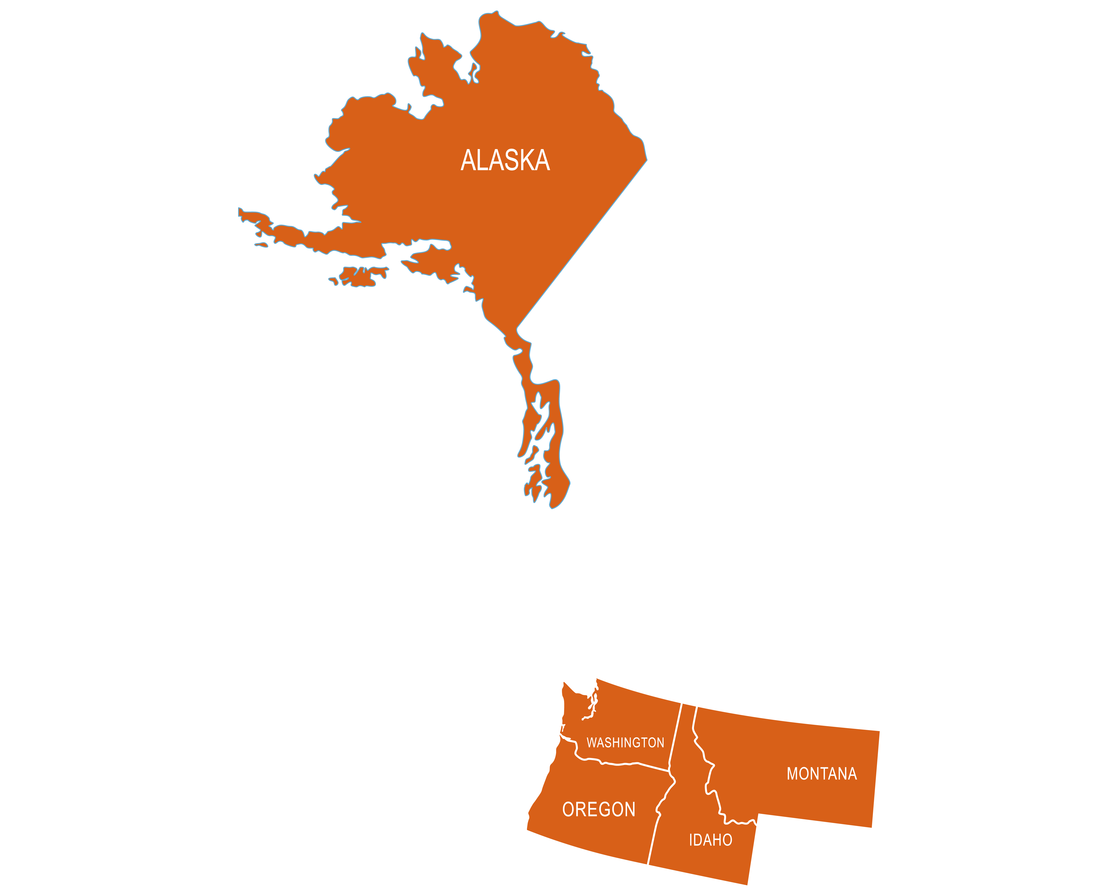
Subtitle
North Pacific Union Conference
Title
Bullet 1
Bullet 2
Bullet 3
Sub-bullet 1
Sub-bullet 2
Sub-bullet 3
Bullet 4
Bullet 5

Slide 6
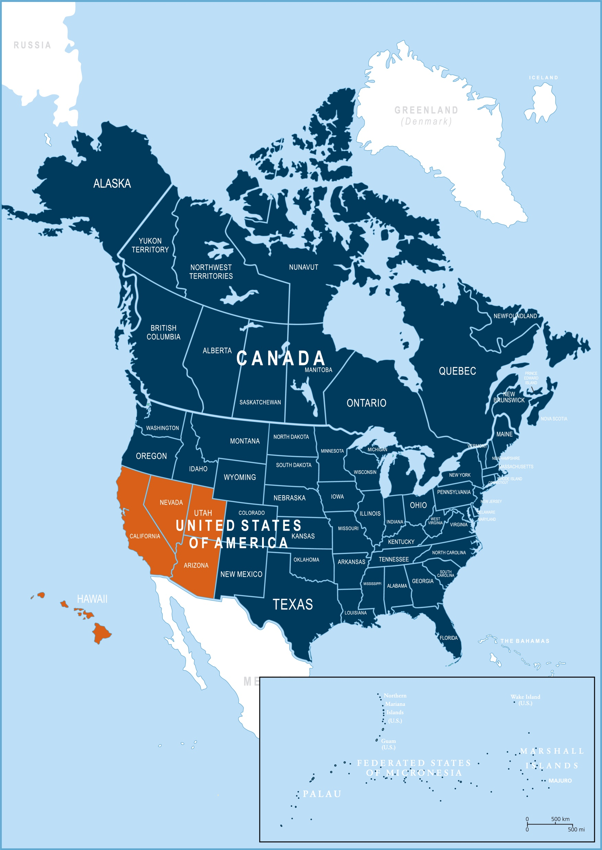
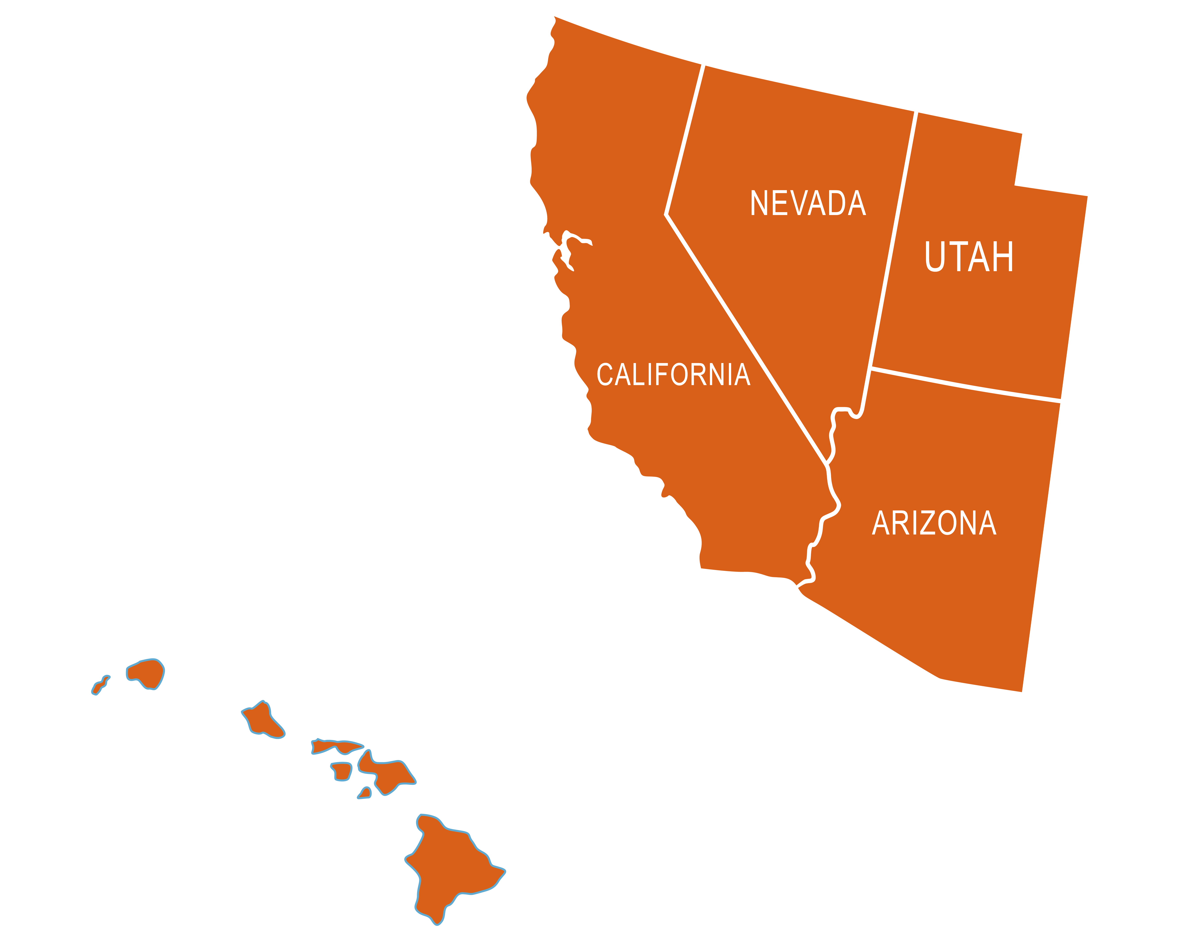
Subtitle
Pacific Union Conference
Title
Bullet 1
Bullet 2
Bullet 3
Sub-bullet 1
Sub-bullet 2
Sub-bullet 3
Bullet 4
Bullet 5

Slide 7
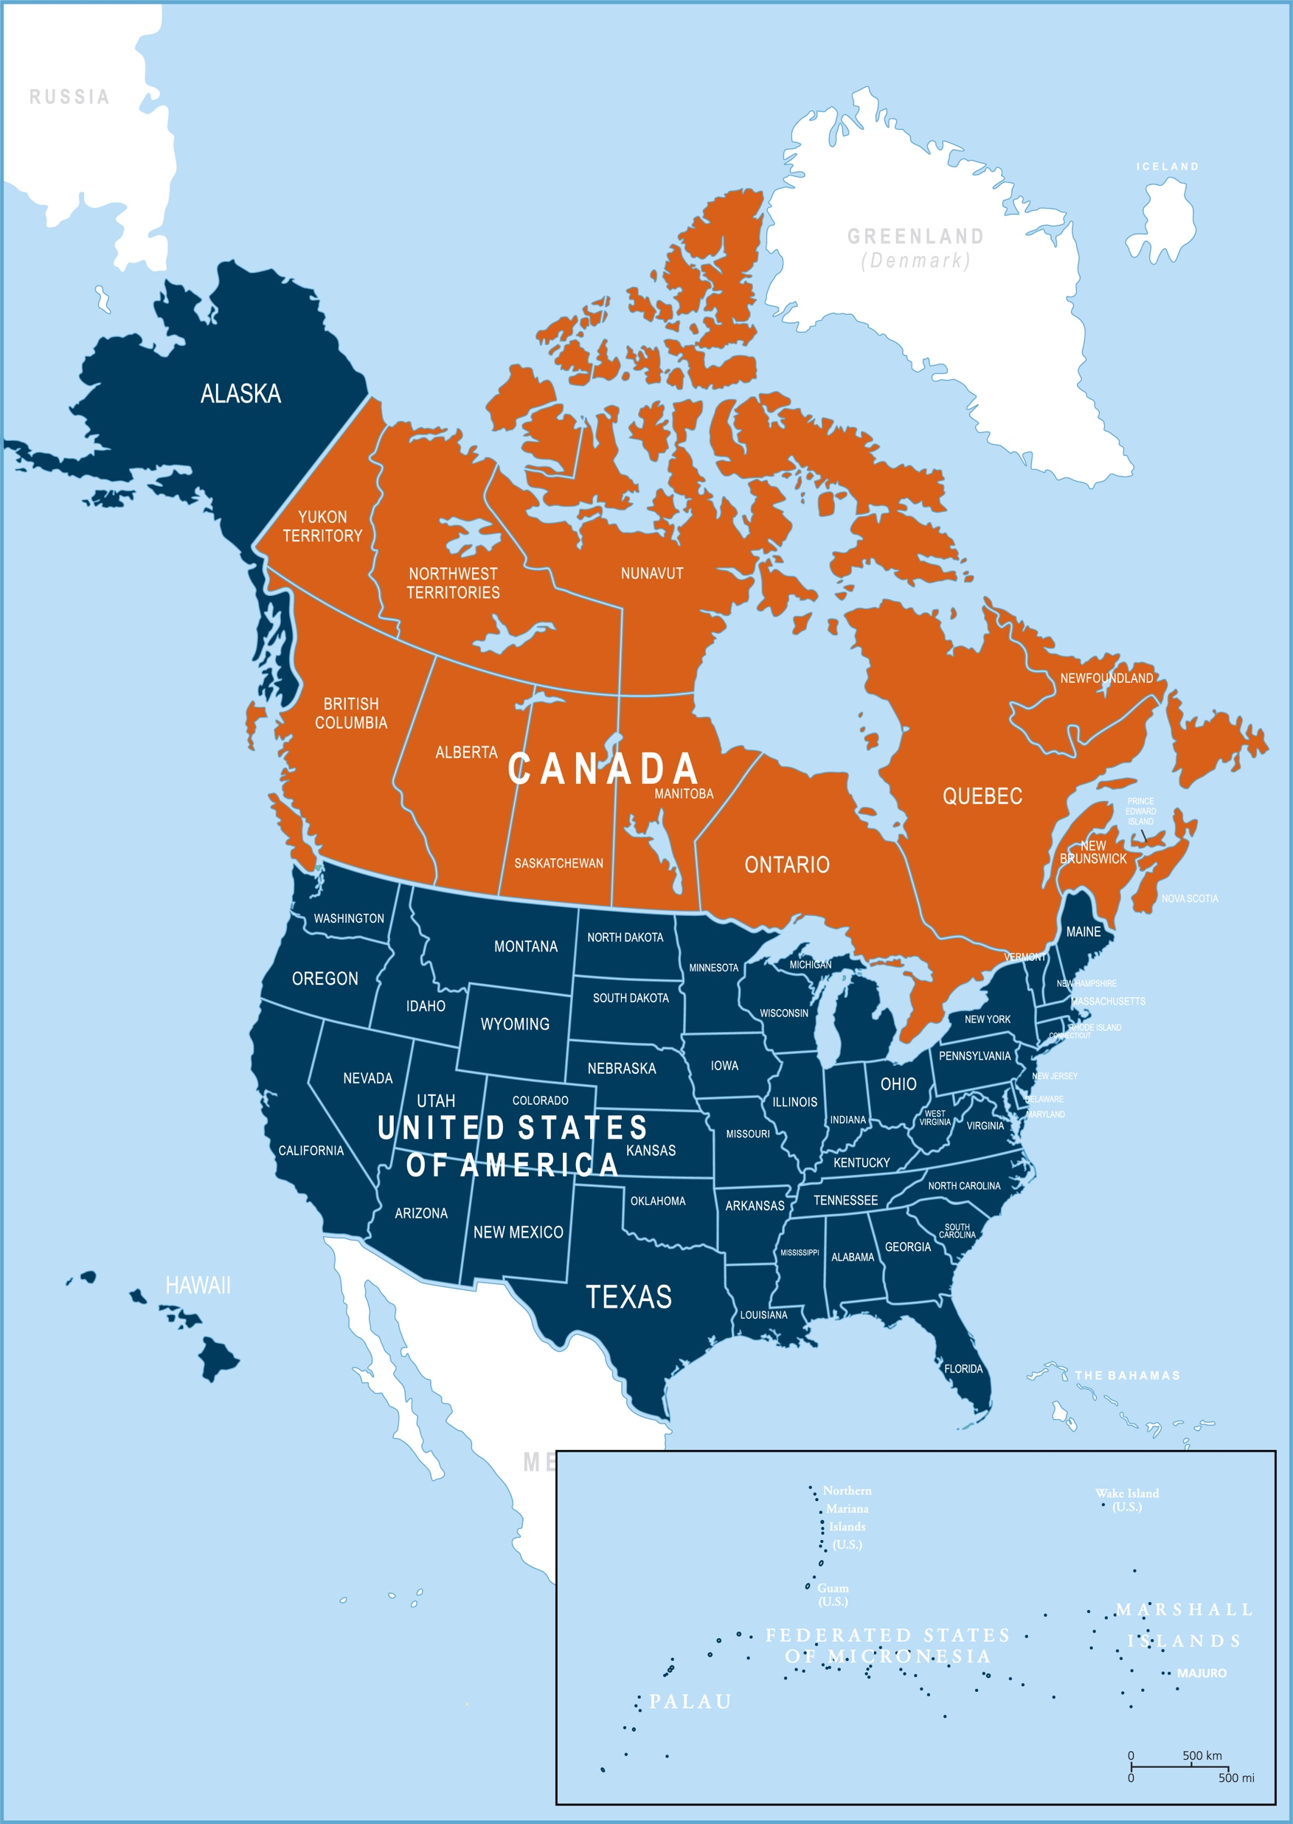
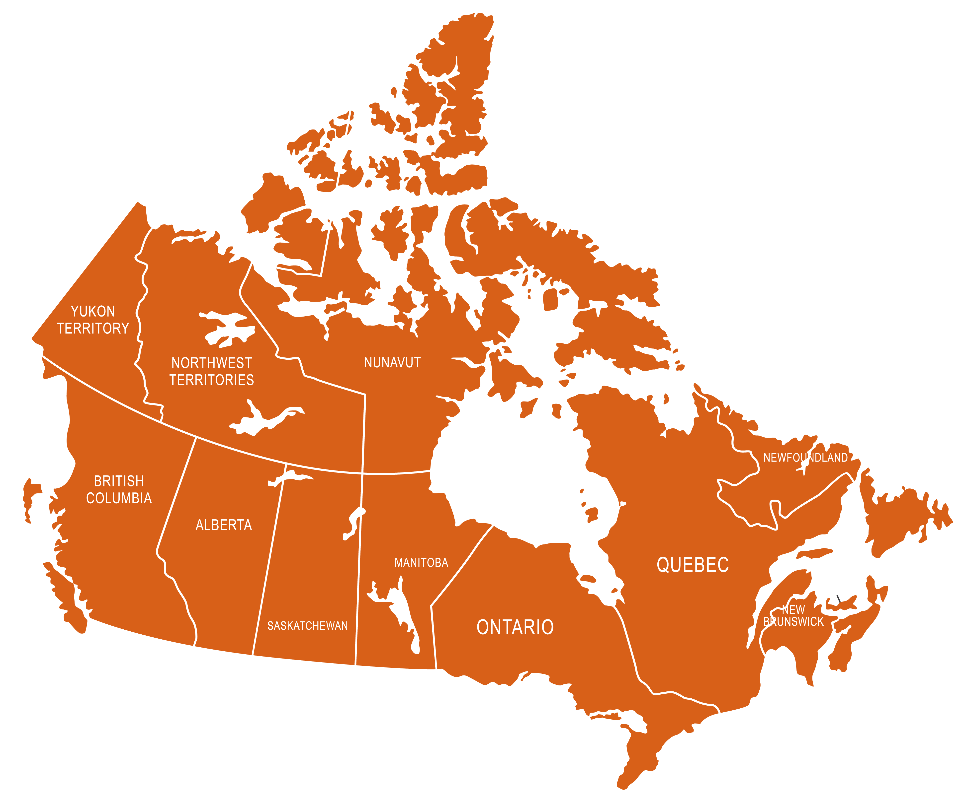
Subtitle
Seventh-day Adventist Church in Canada
Title
Bullet 1
Bullet 2
Bullet 3
Sub-bullet 1
Sub-bullet 2
Sub-bullet 3
Bullet 4
Bullet 5

Slide 8
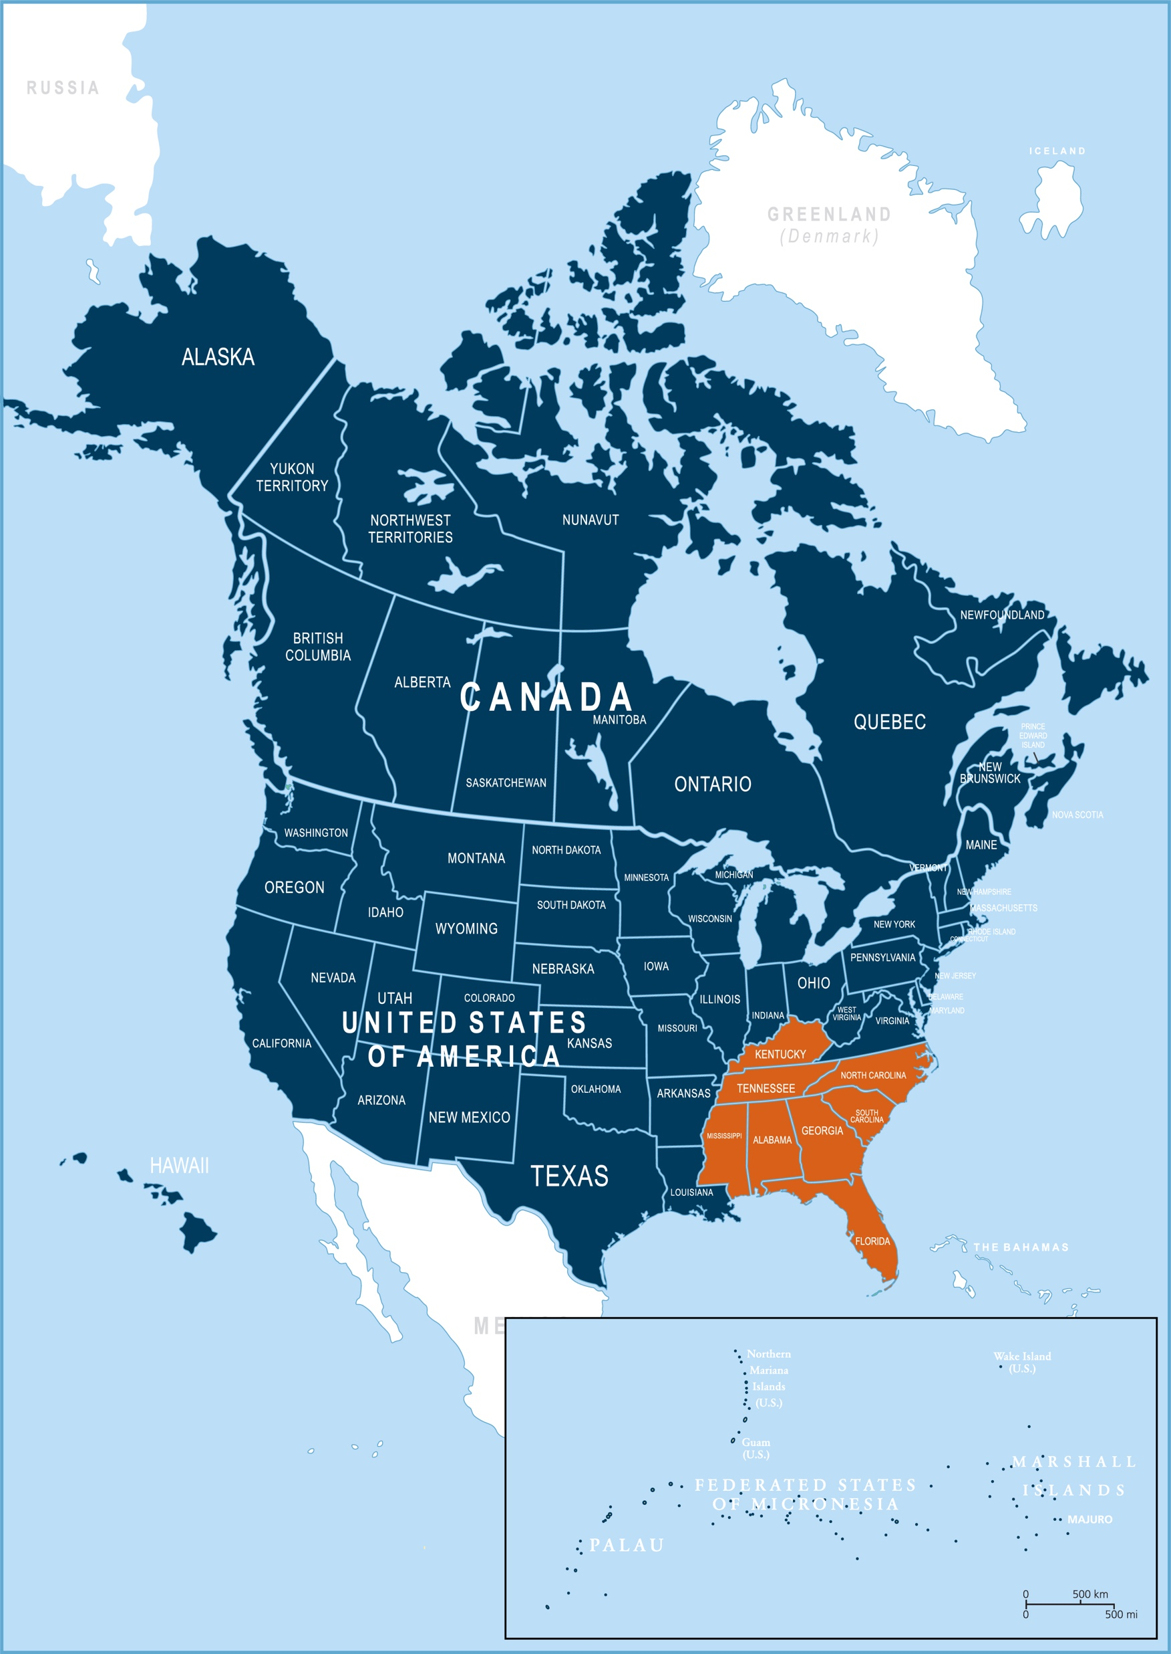
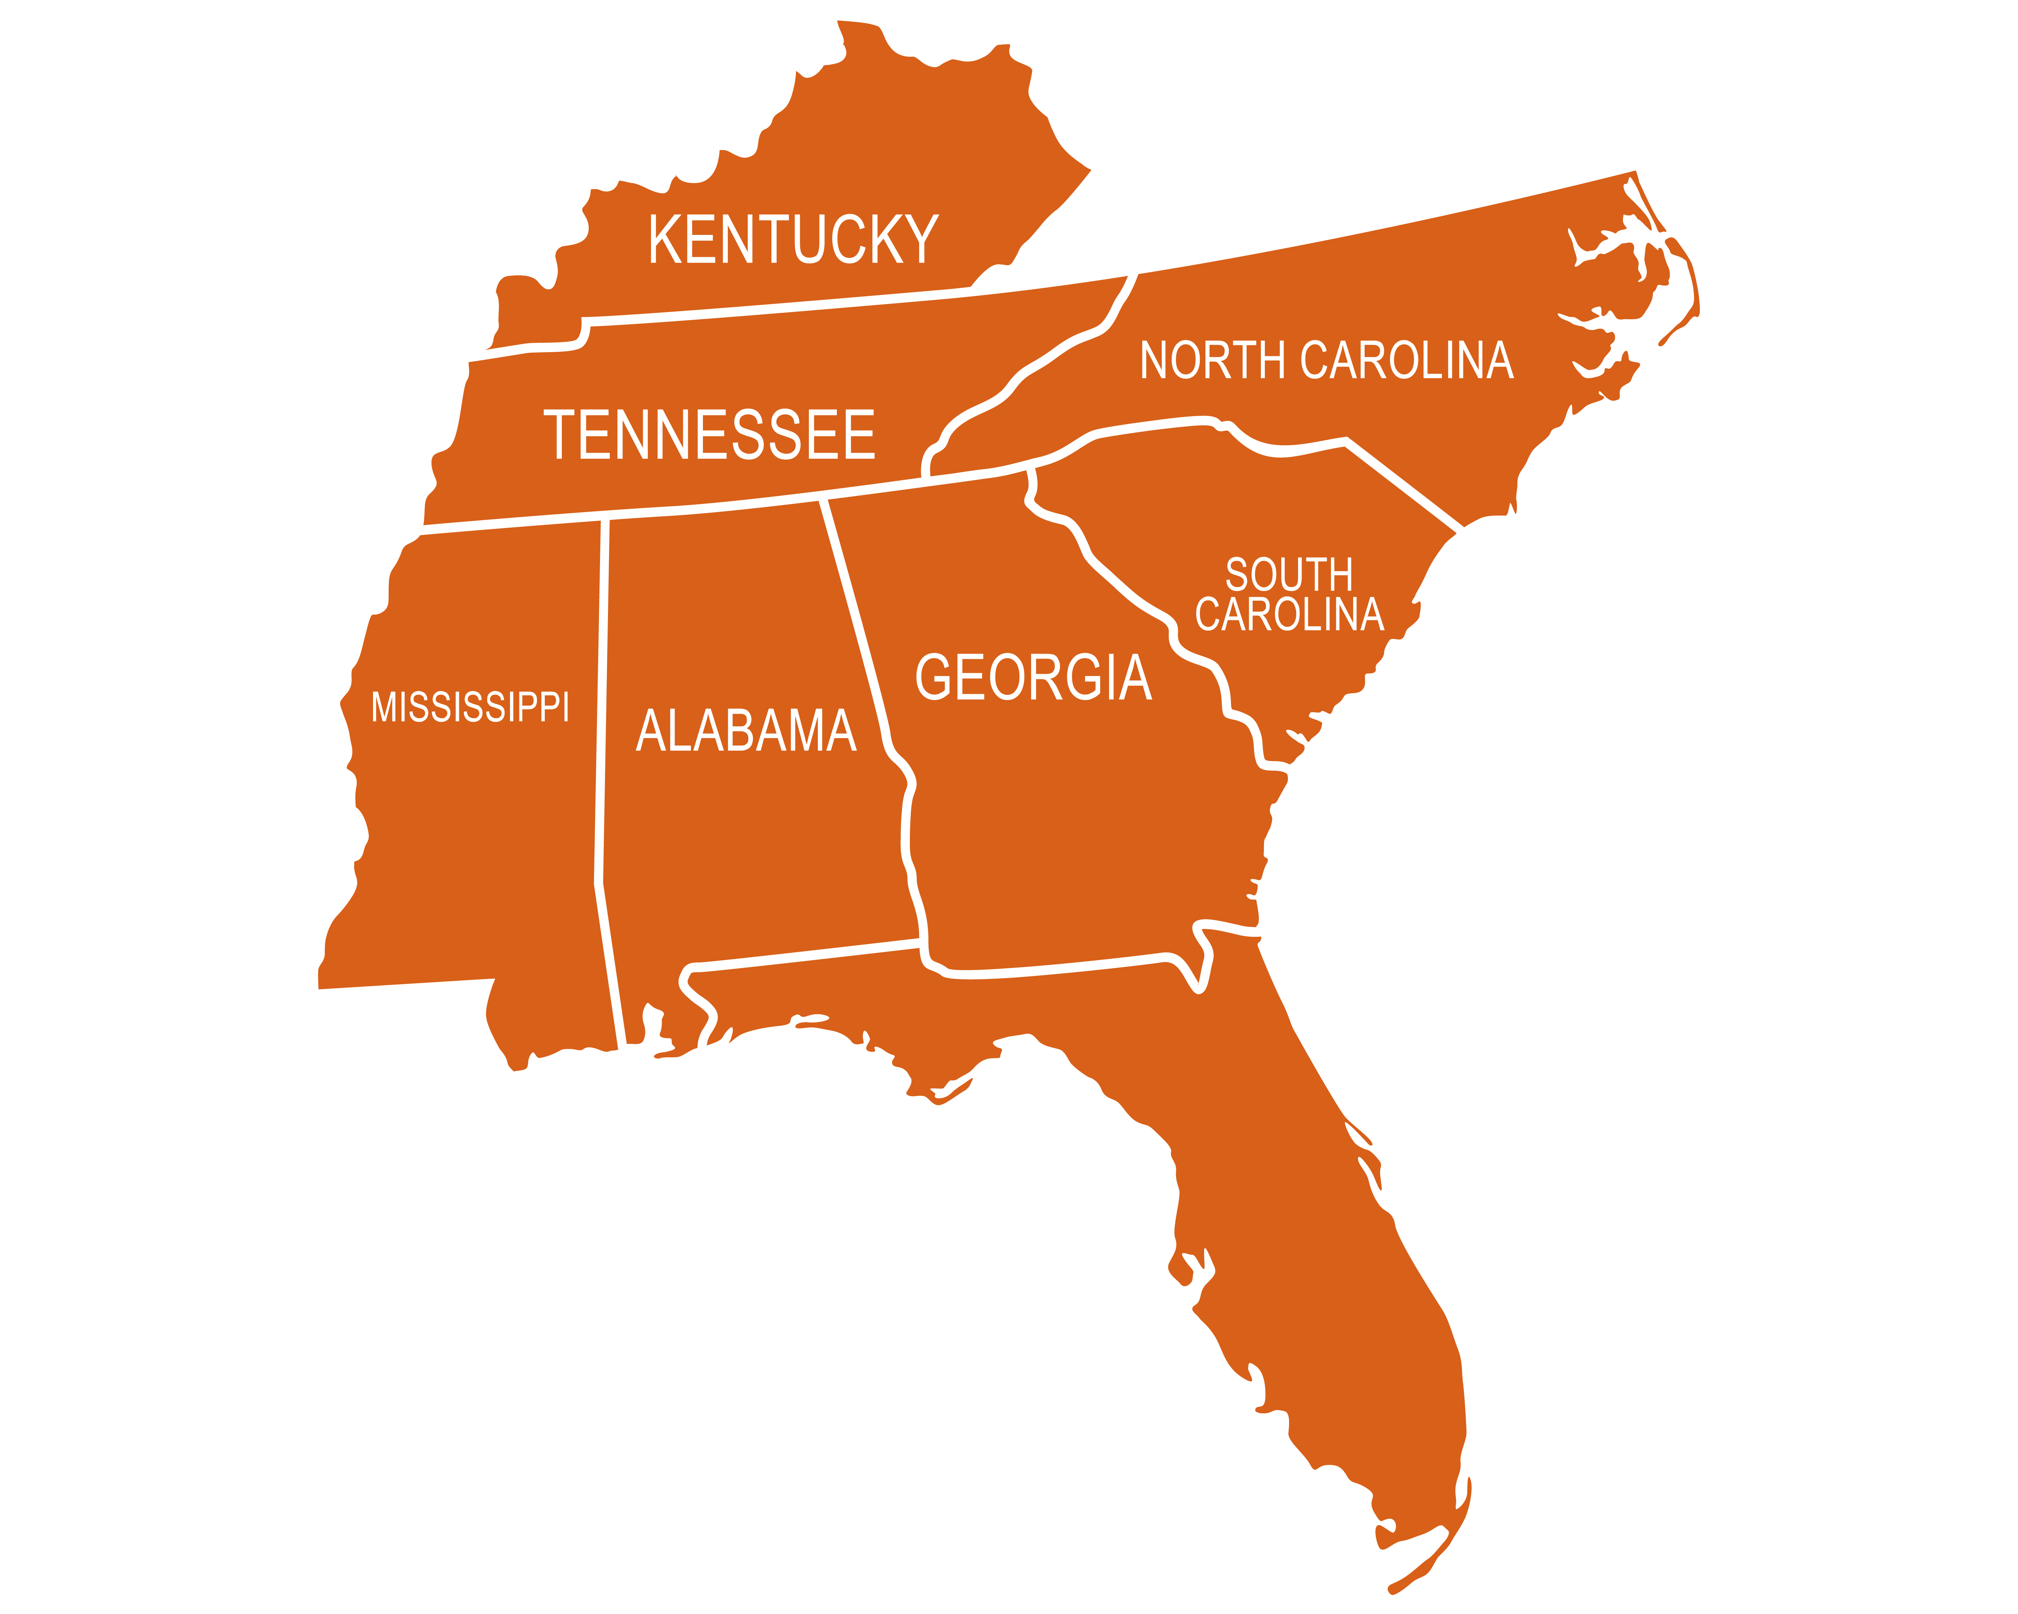
Subtitle
Southern Union Conference
Title
Bullet 1
Bullet 2
Bullet 3
Sub-bullet 1
Sub-bullet 2
Sub-bullet 3
Bullet 4
Bullet 5

Slide 9
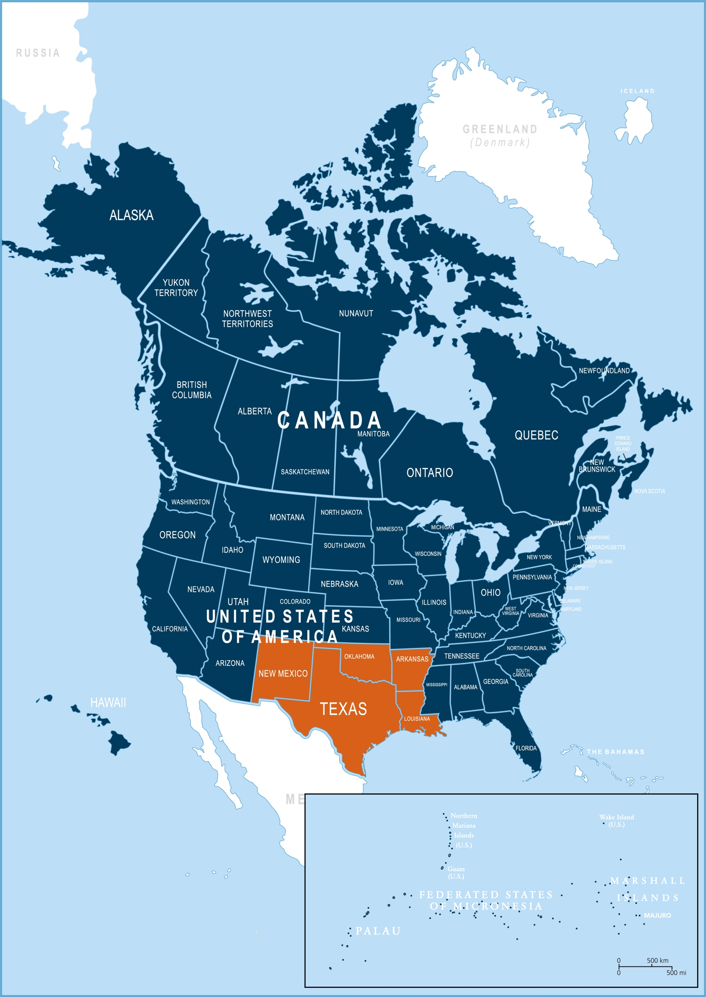
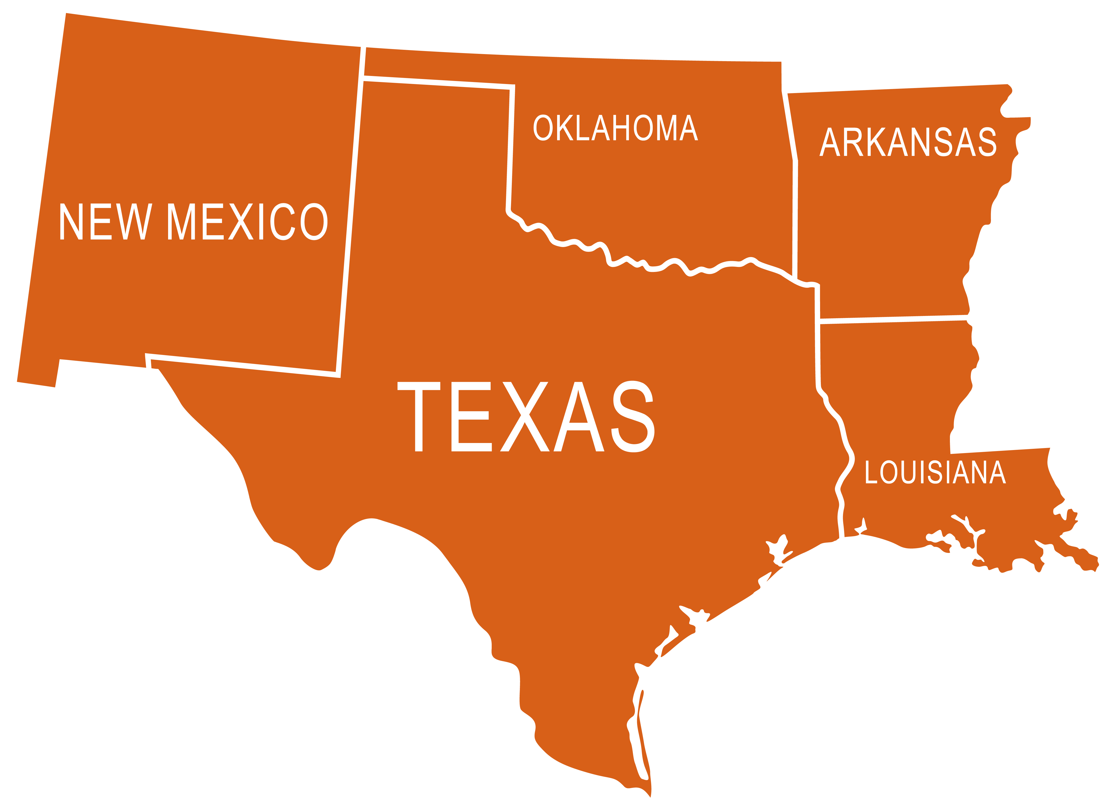
Subtitle
Southwestern Union Conference
Title
Bullet 1
Bullet 2
Bullet 3
Sub-bullet 1
Sub-bullet 2
Sub-bullet 3
Bullet 4
Bullet 5

Slide 10
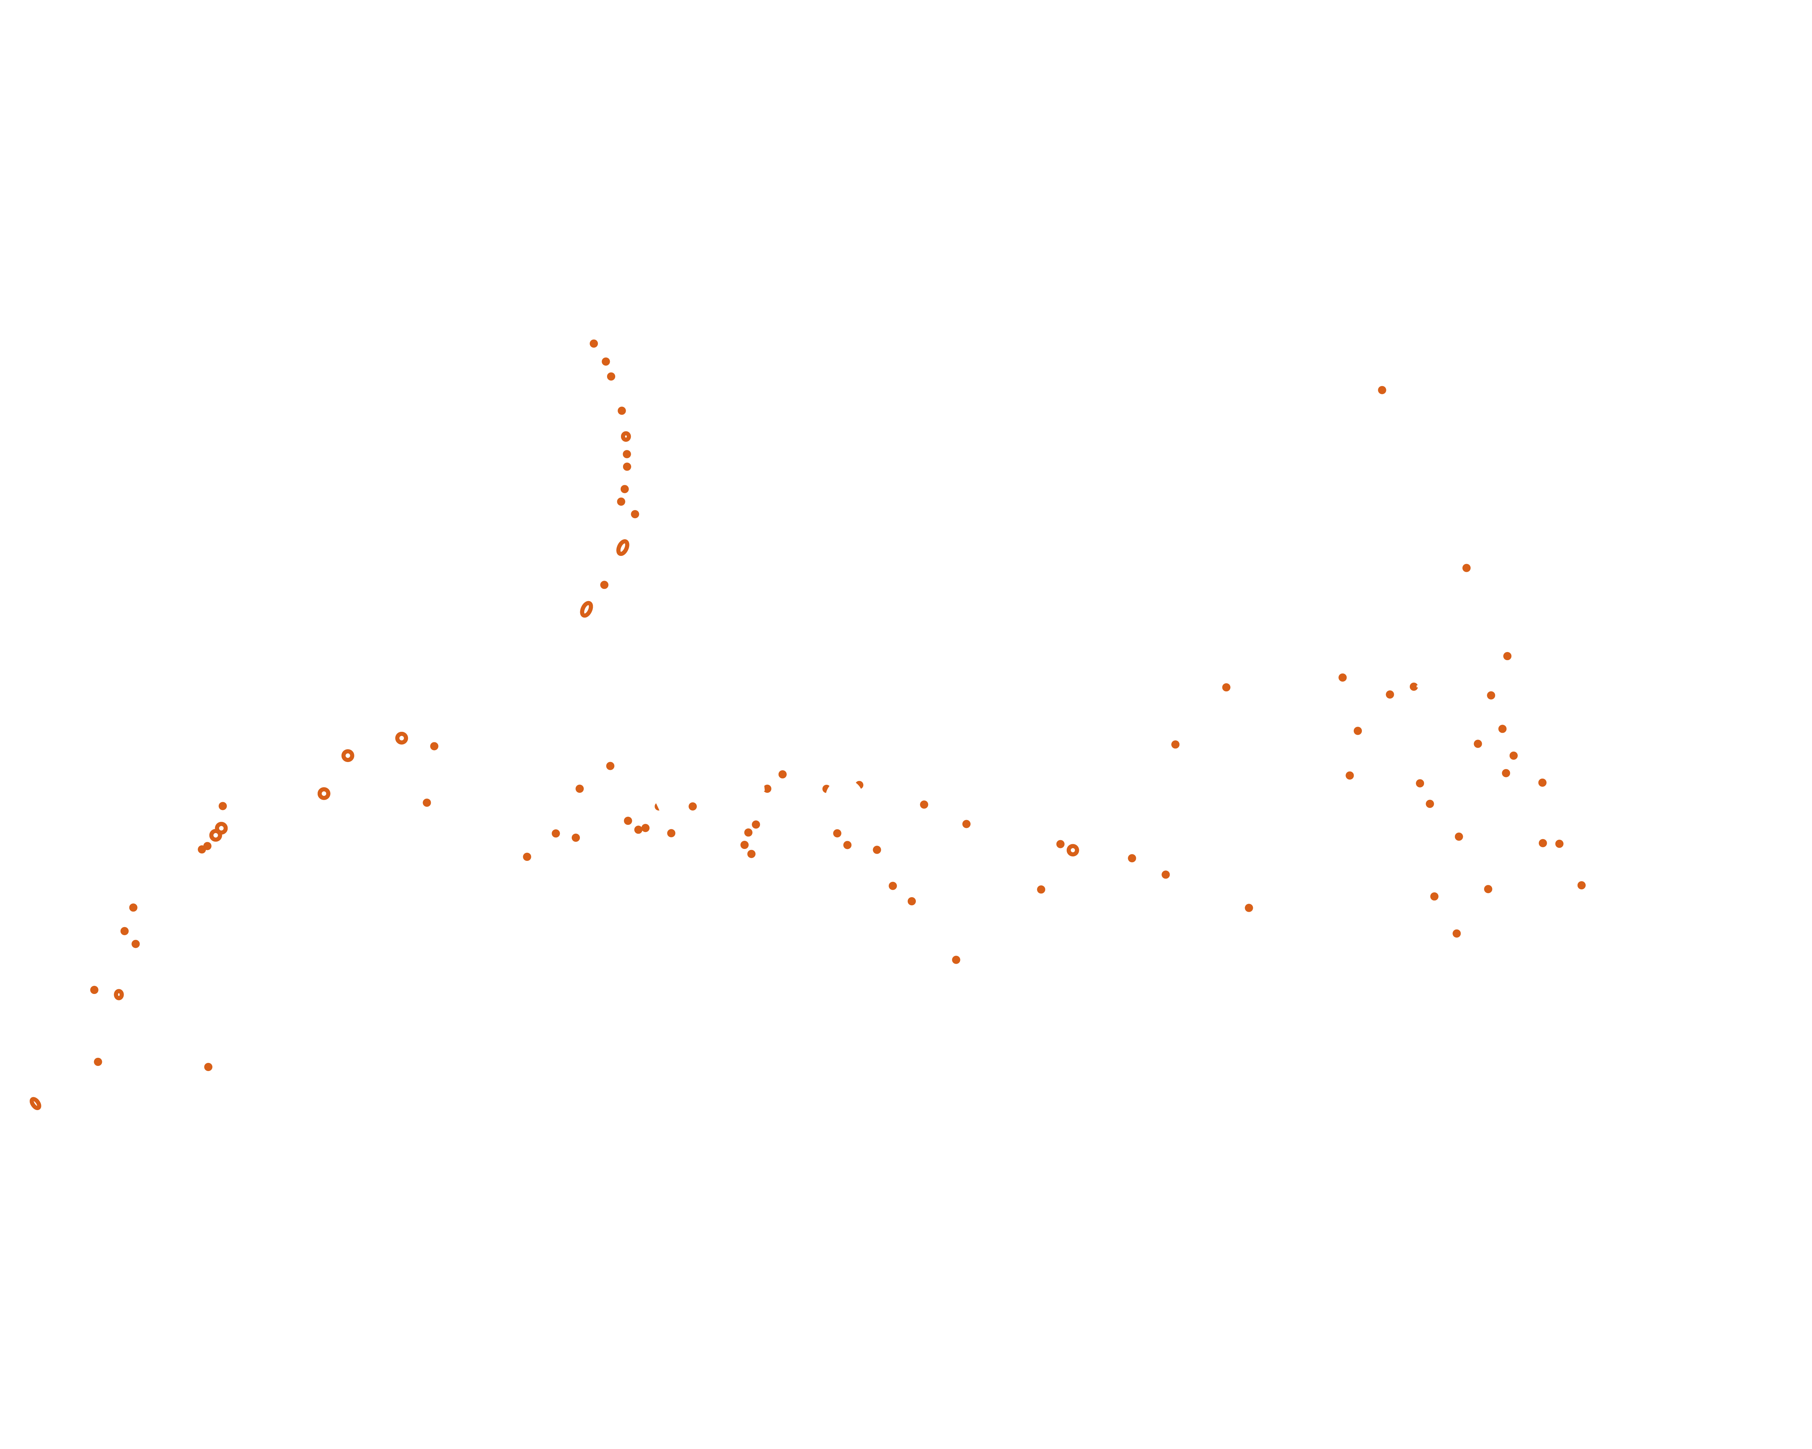
Guam-Micronesia Mission
Title
Bullet 1
Bullet 2
Bullet 3
Sub-bullet 1
Sub-bullet 2
Sub-bullet 3
Bullet 4
Bullet 5

